Slide 1
Fake News, Fact-checking, Stance
http://www.ixa.eus/iltapp/
@ragerri @joseba_fdl @iker_garciaf #iltapp
Some slides adapted from IJCAI 2021 T15 tutorial

Slide 2
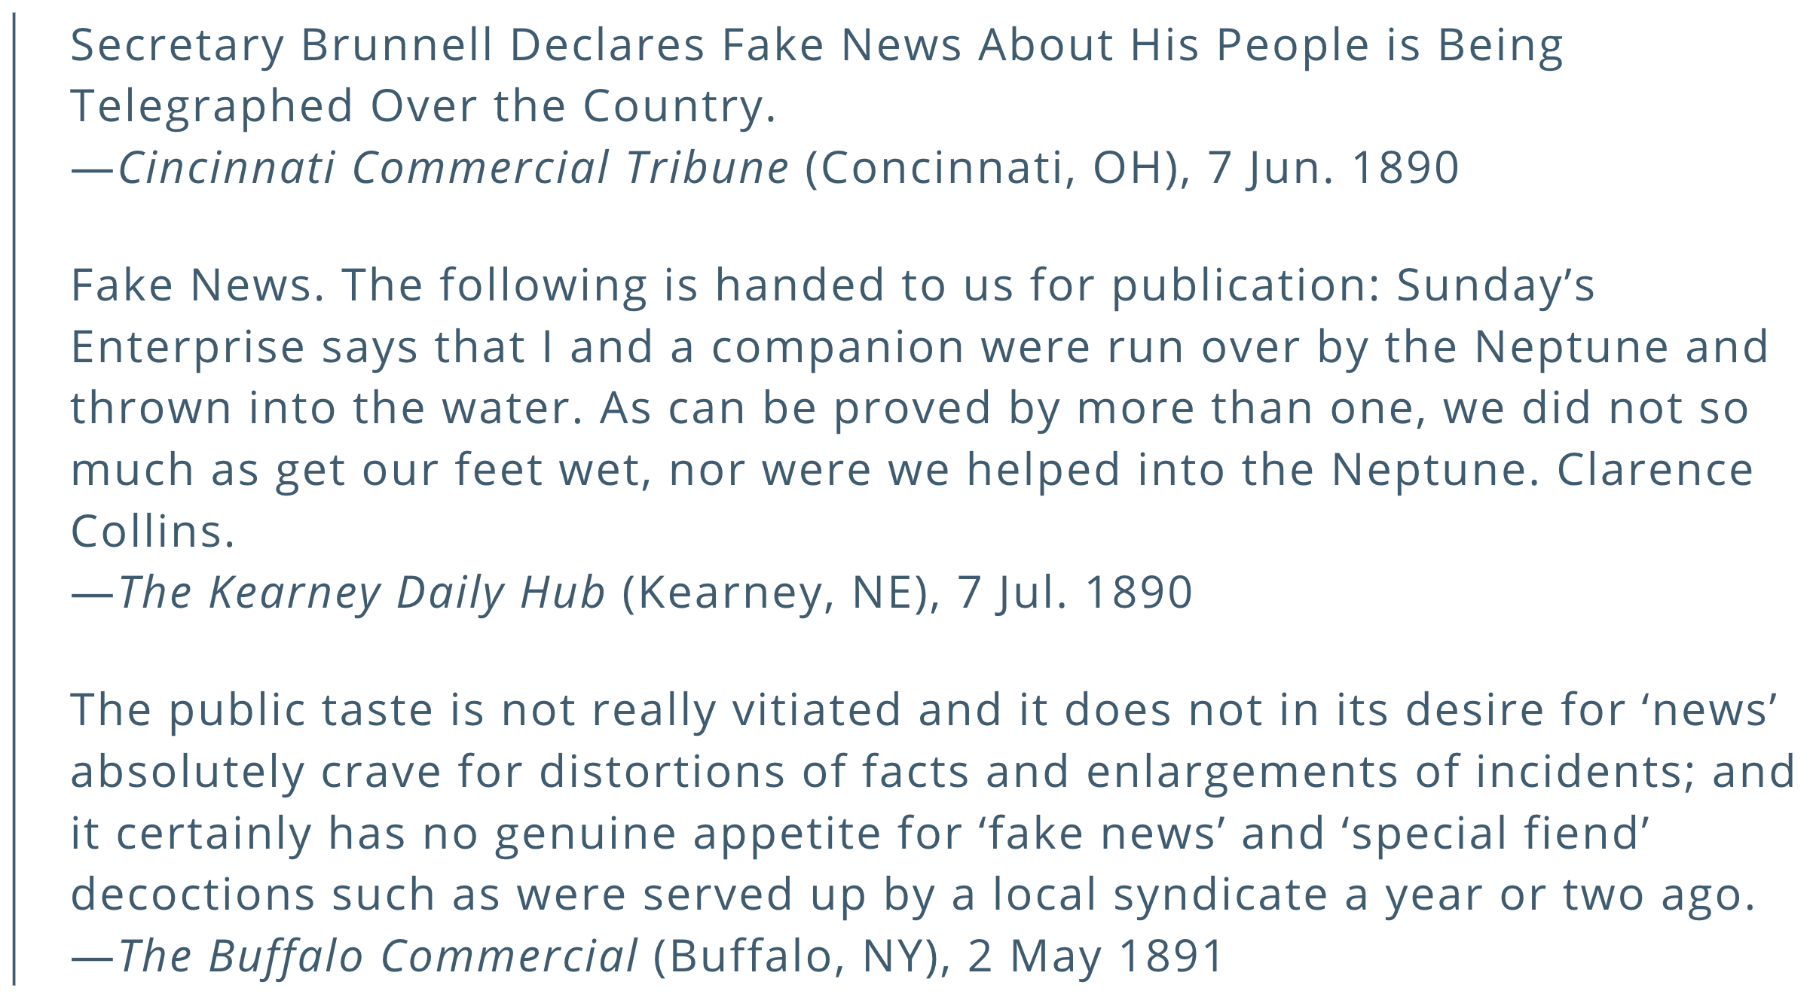
Fake news

Slide 3
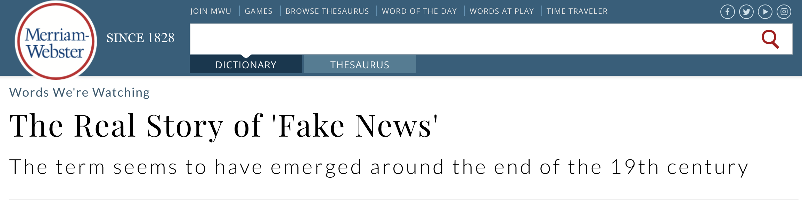
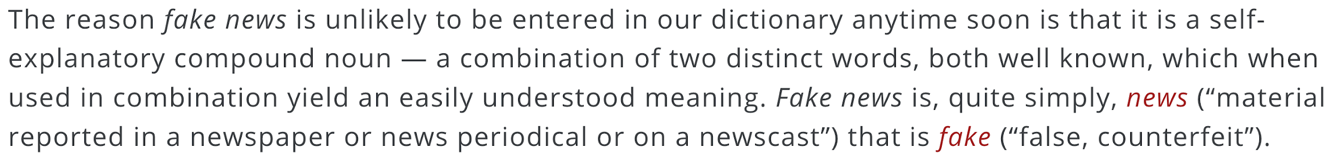
Fake news

Slide 4
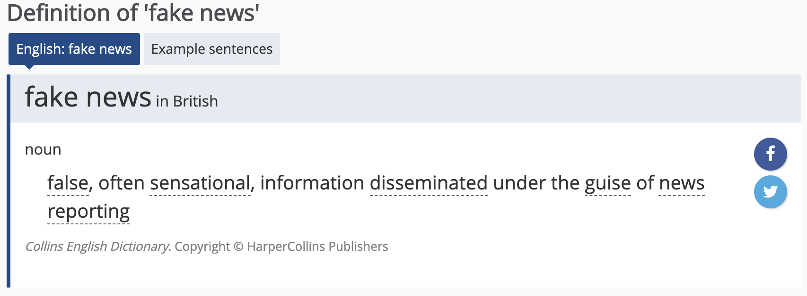
Fake news

Slide 5
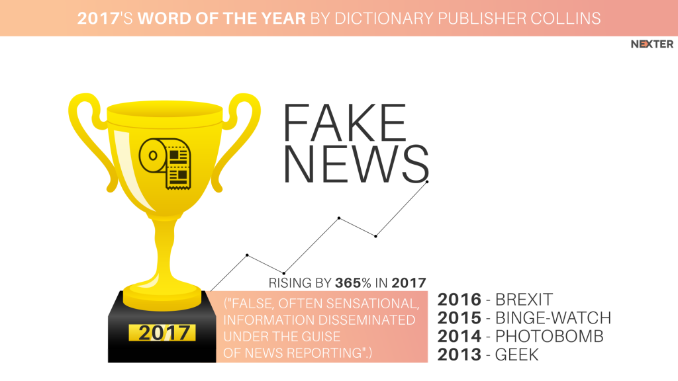
Fake news

Slide 6
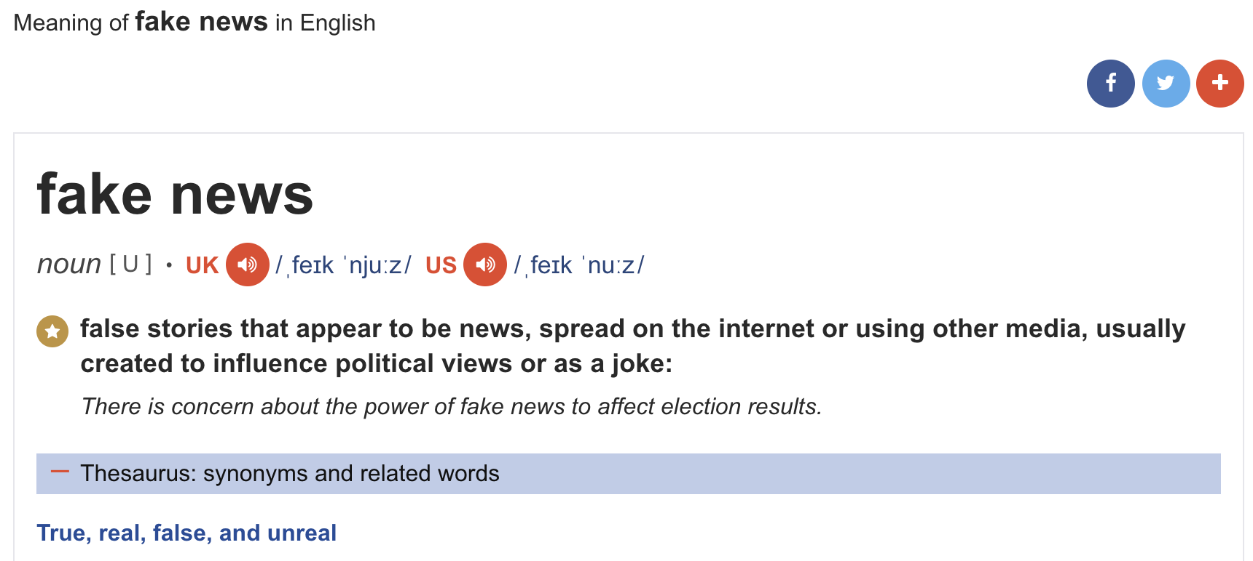
Fake news (Cambridge dictionary)

Slide 7
Fake news (https://en.wikipedia.org/wiki/Fake_news)
Fake news is a neologism often used to refer to fabricated news. This type of news, found in traditional news, social media or fake news websites, has no basis in fact, but is presented as being factually accurate.
Fake news is a type of yellow journalism or propaganda that consists of deliberate disinformation or hoaxes spread via traditional news media (print and broadcast) or online social media
Fake news is written and published usually with the intent to mislead in order to damage an agency, entity, or person, and/or gain financially or politically, often using sensationalist, dishonest, or outright fabricated headlines to increase readership. Similarly, clickbait stories and headlines earn advertising revenue from this activity.

Slide 8
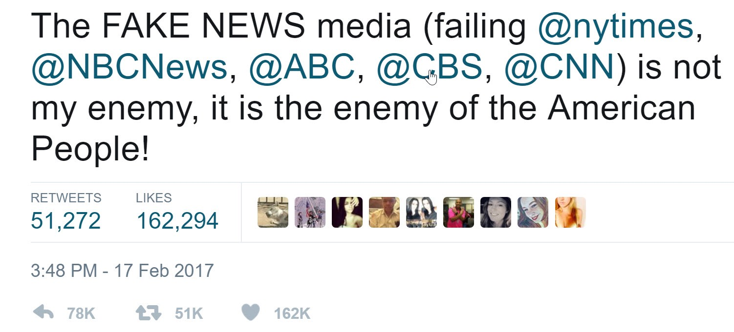
Fake news (news one person does not like)

Slide 9
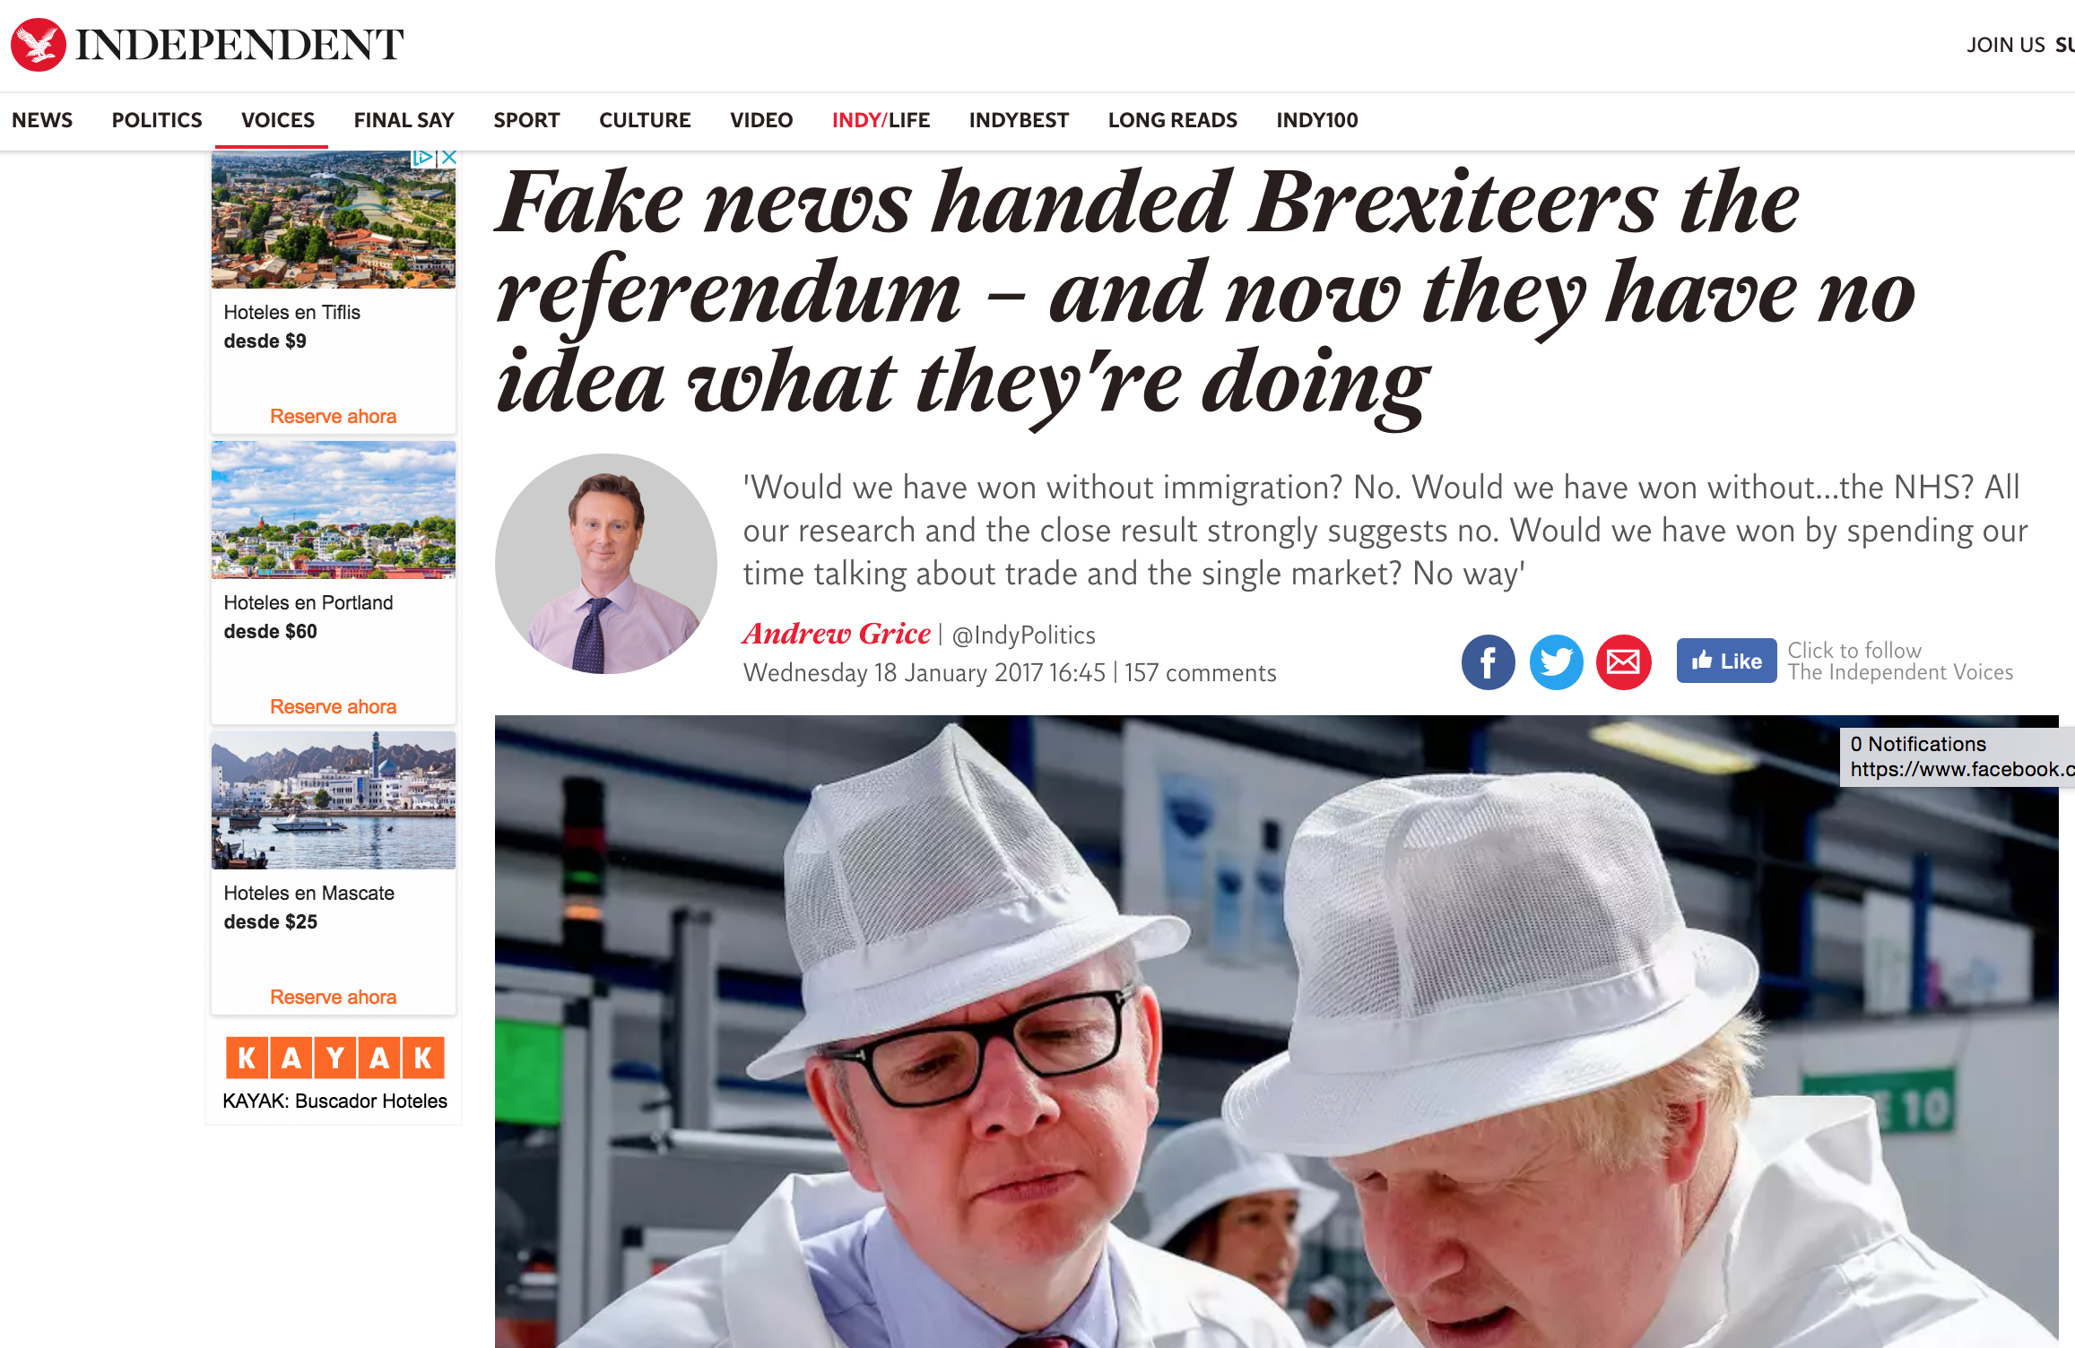
Consequences of Fake news

Slide 10
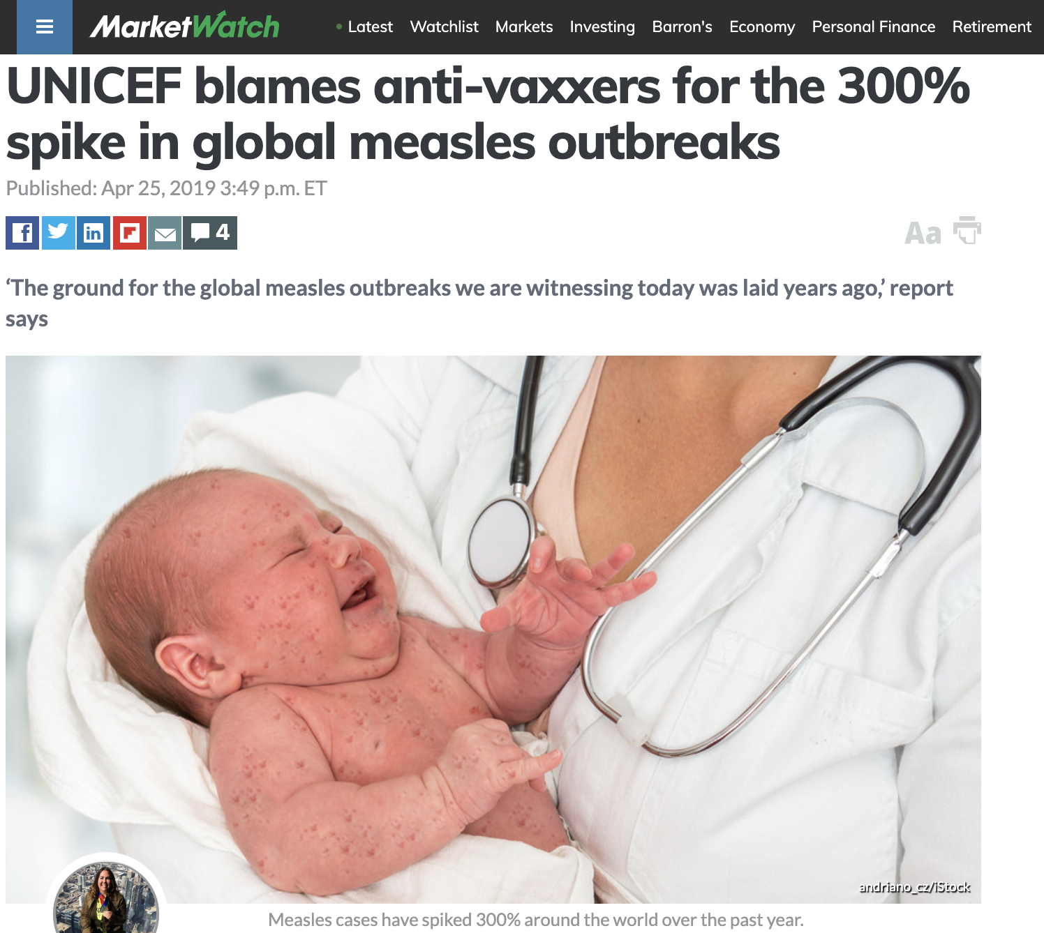
Consequences of Fake news

Slide 11
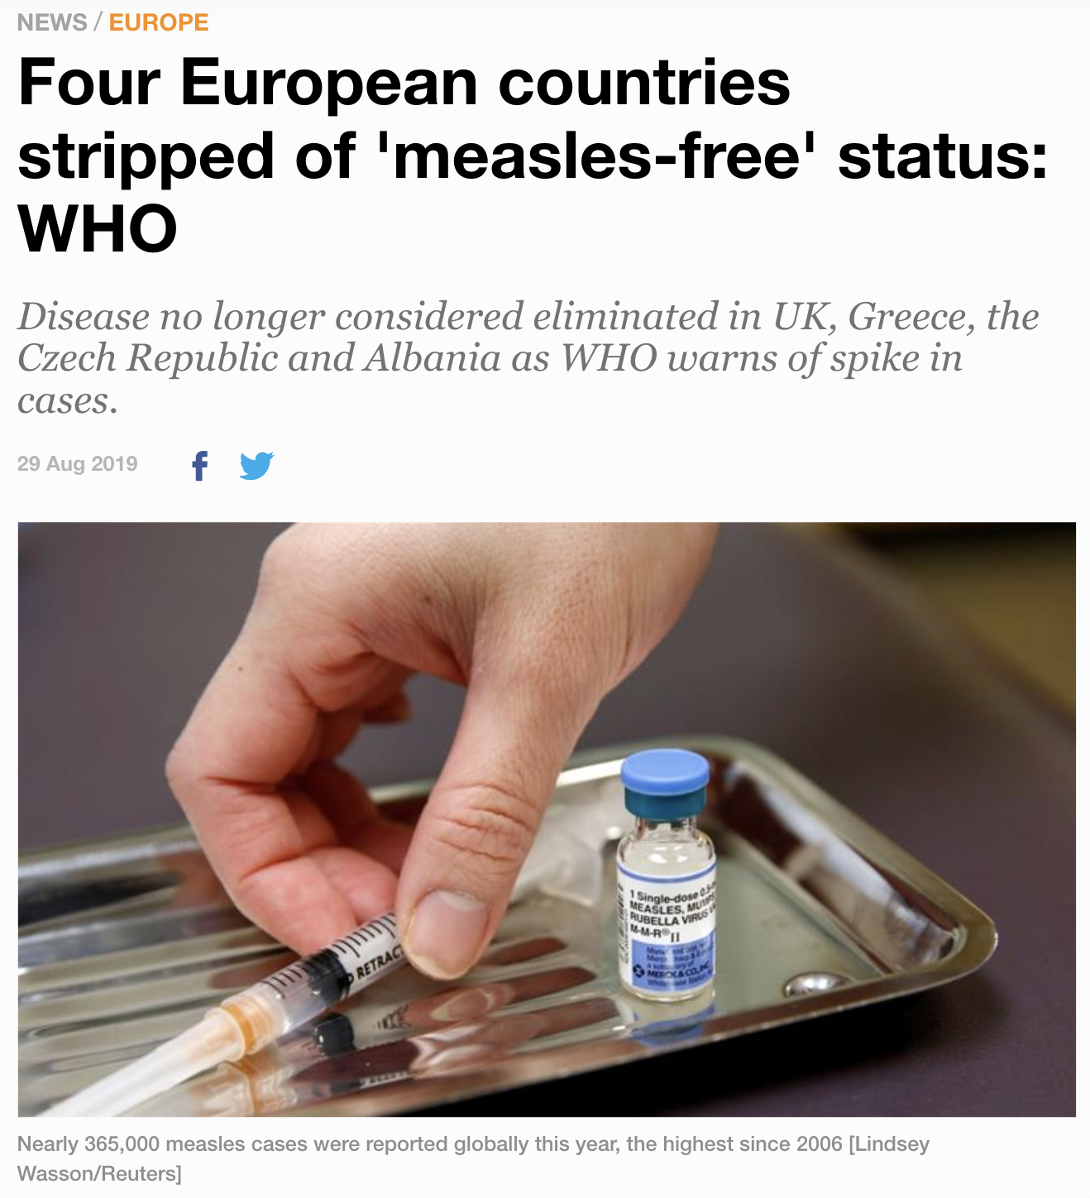
Consequences of Fake news
https://www.aljazeera.com/news/2019/08/european-countries-stripped-measles-free-status-190829071033053.html

Slide 12
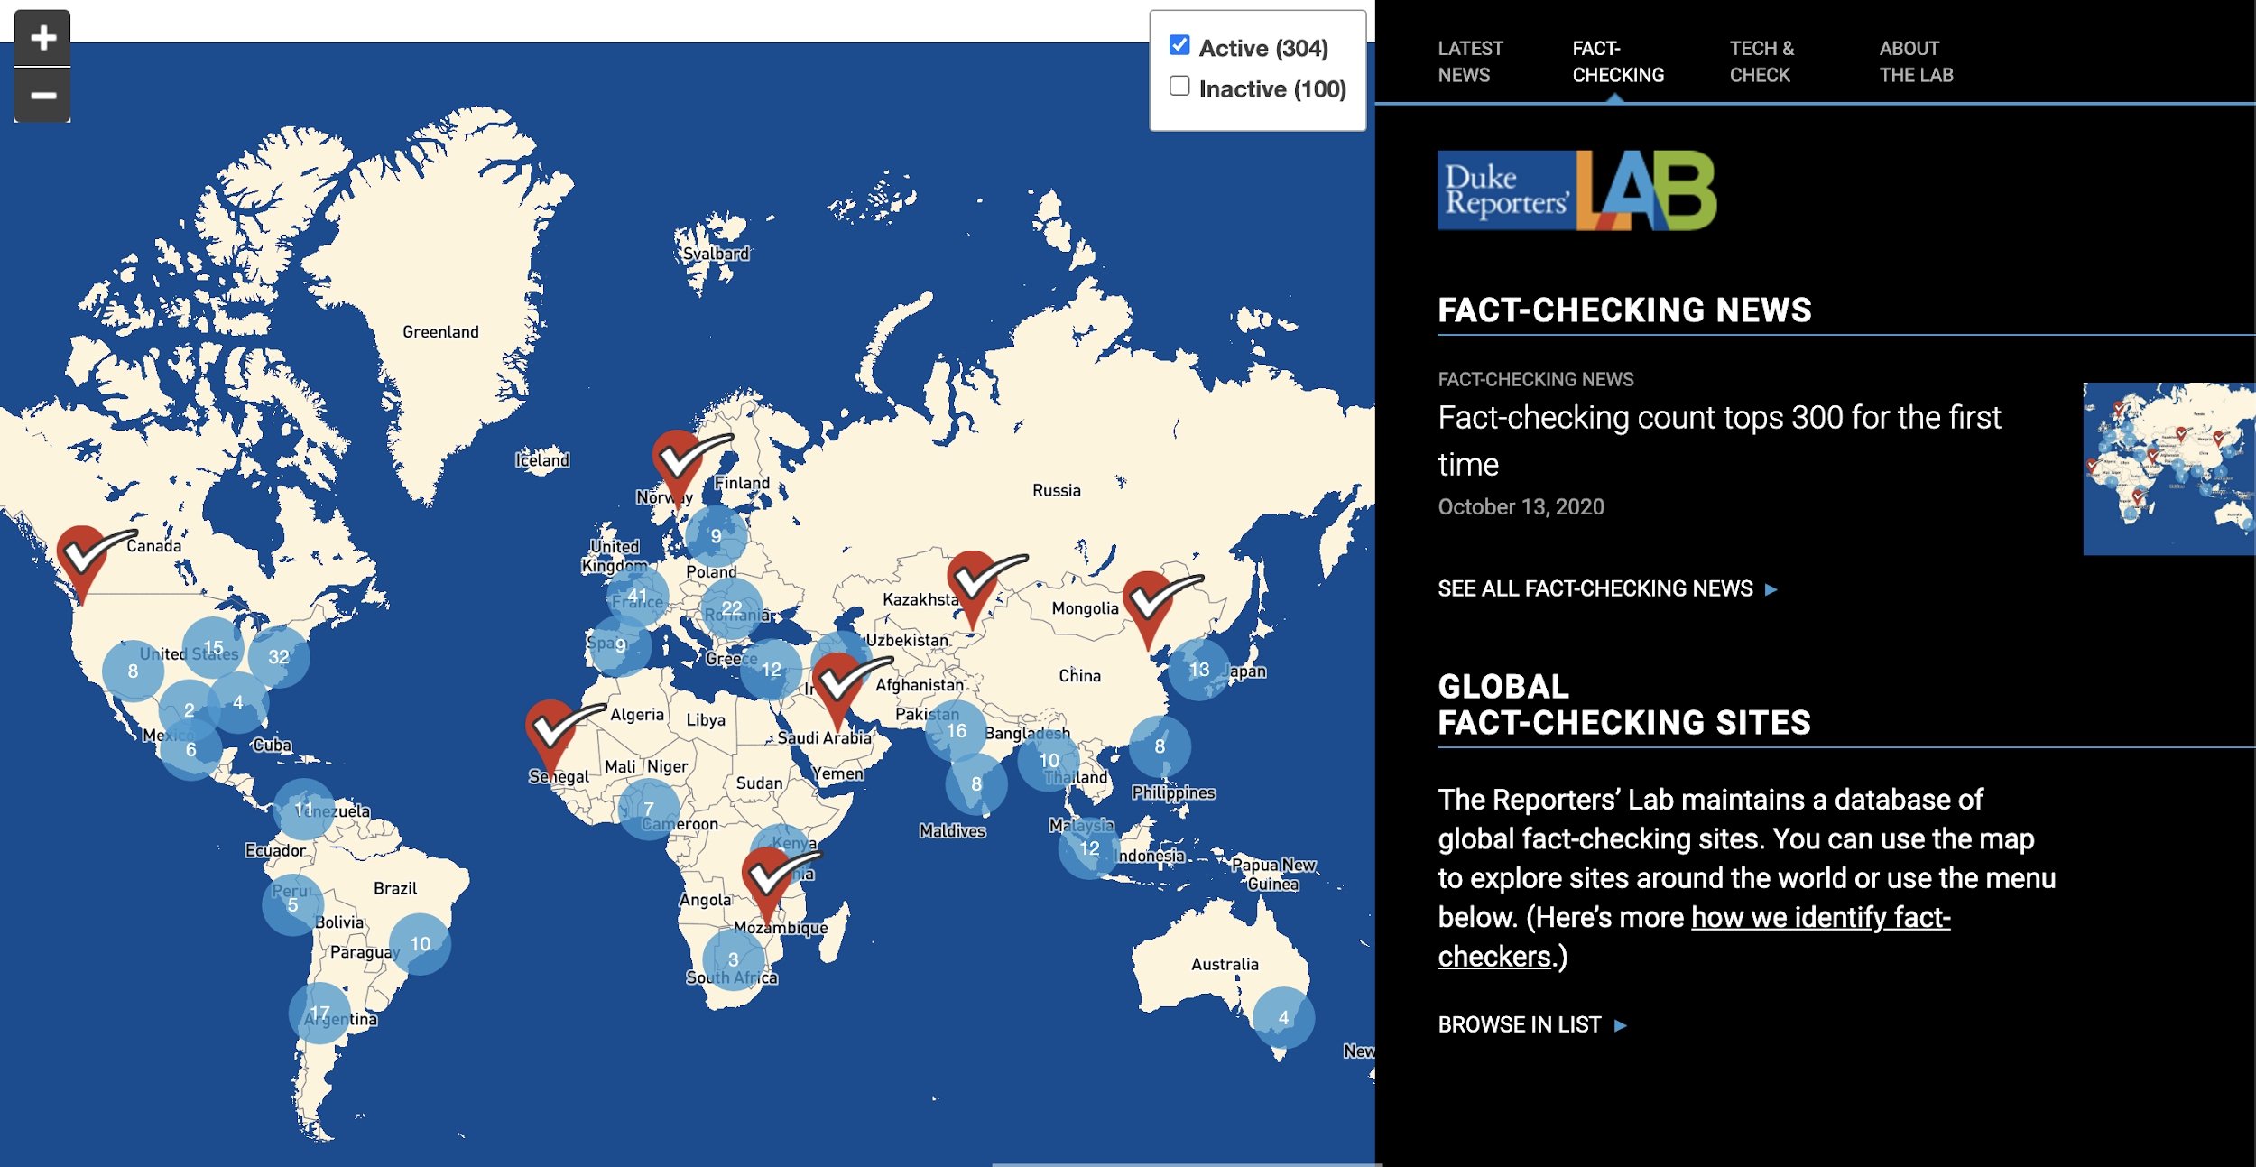
Manual Fact checking

Slide 13
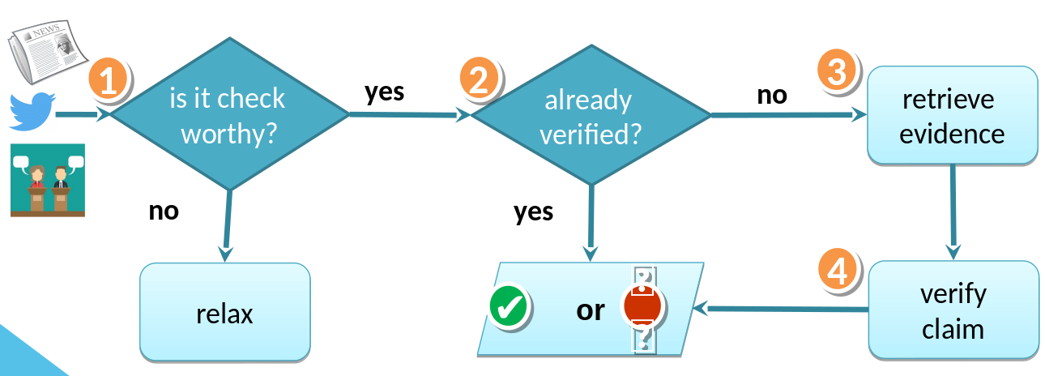
Manual Fact checking

Slide 14
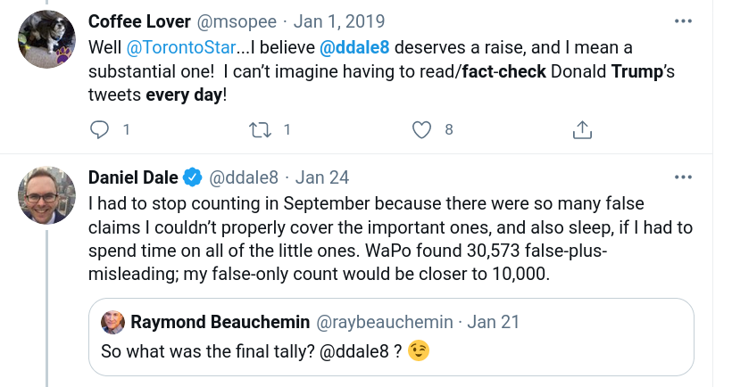
Can we manually fact check every claim?

Slide 15
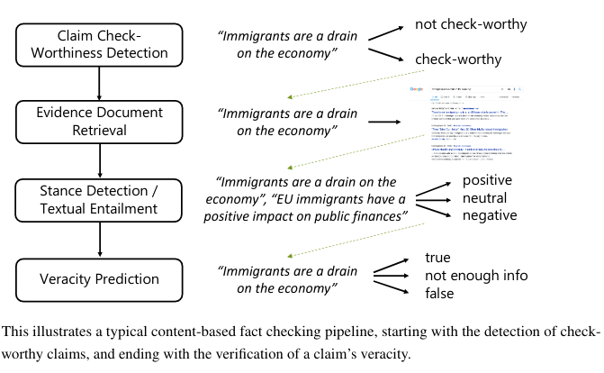
Automated Fact-checking
Augenstein (2021). Towards Explainable Fact-checking. In arxiv.

Slide 16
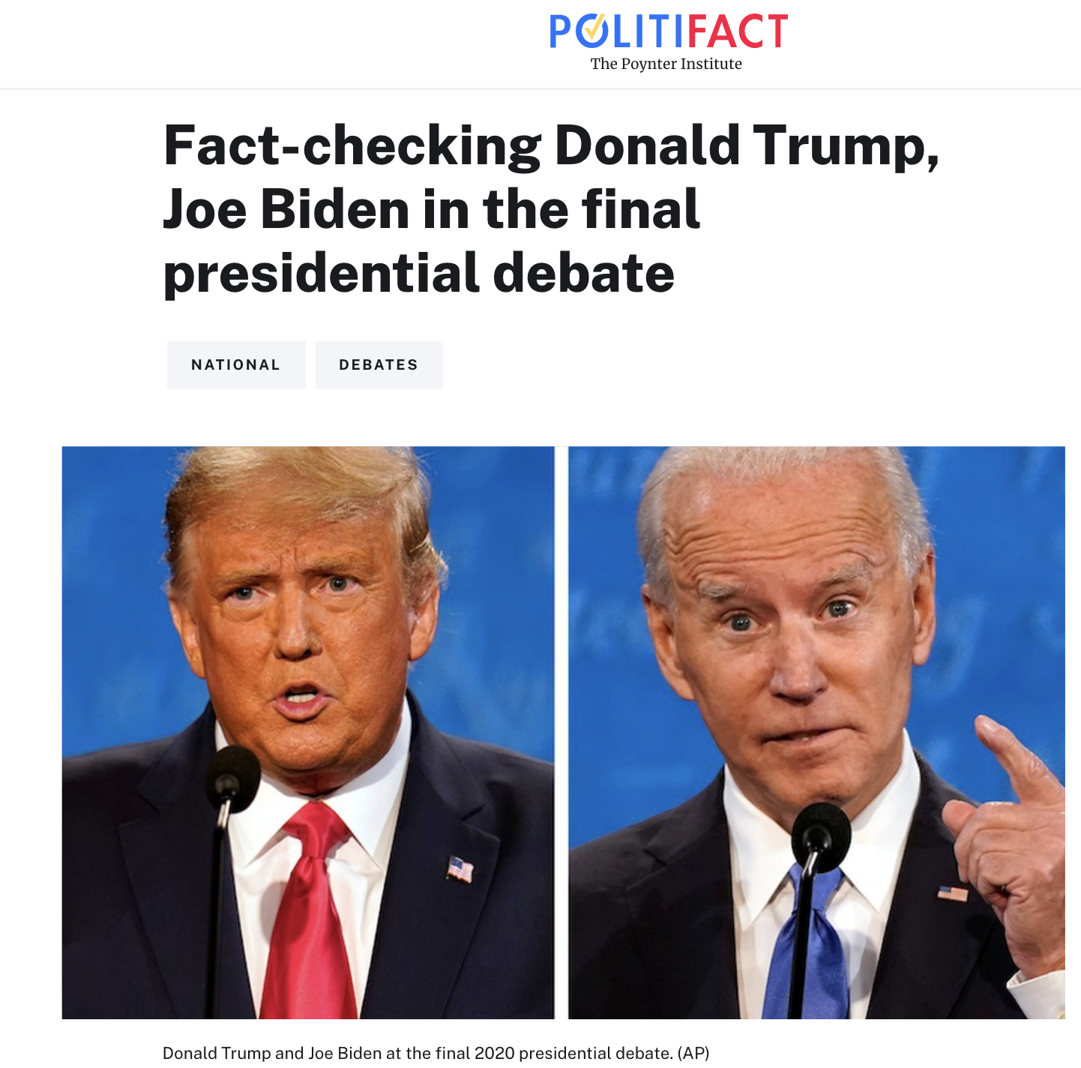
What is worth fact-checking?
1000+ in presidential debate
How to choose what to fact-check?

Slide 17
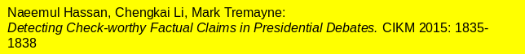
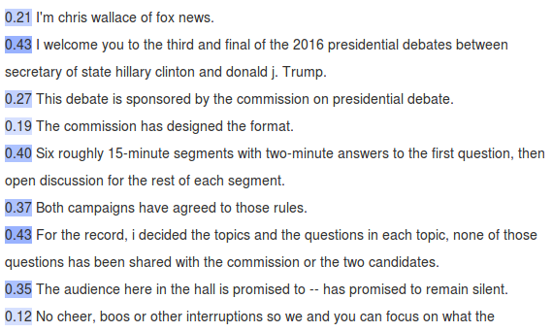
Claimbuster

Slide 18
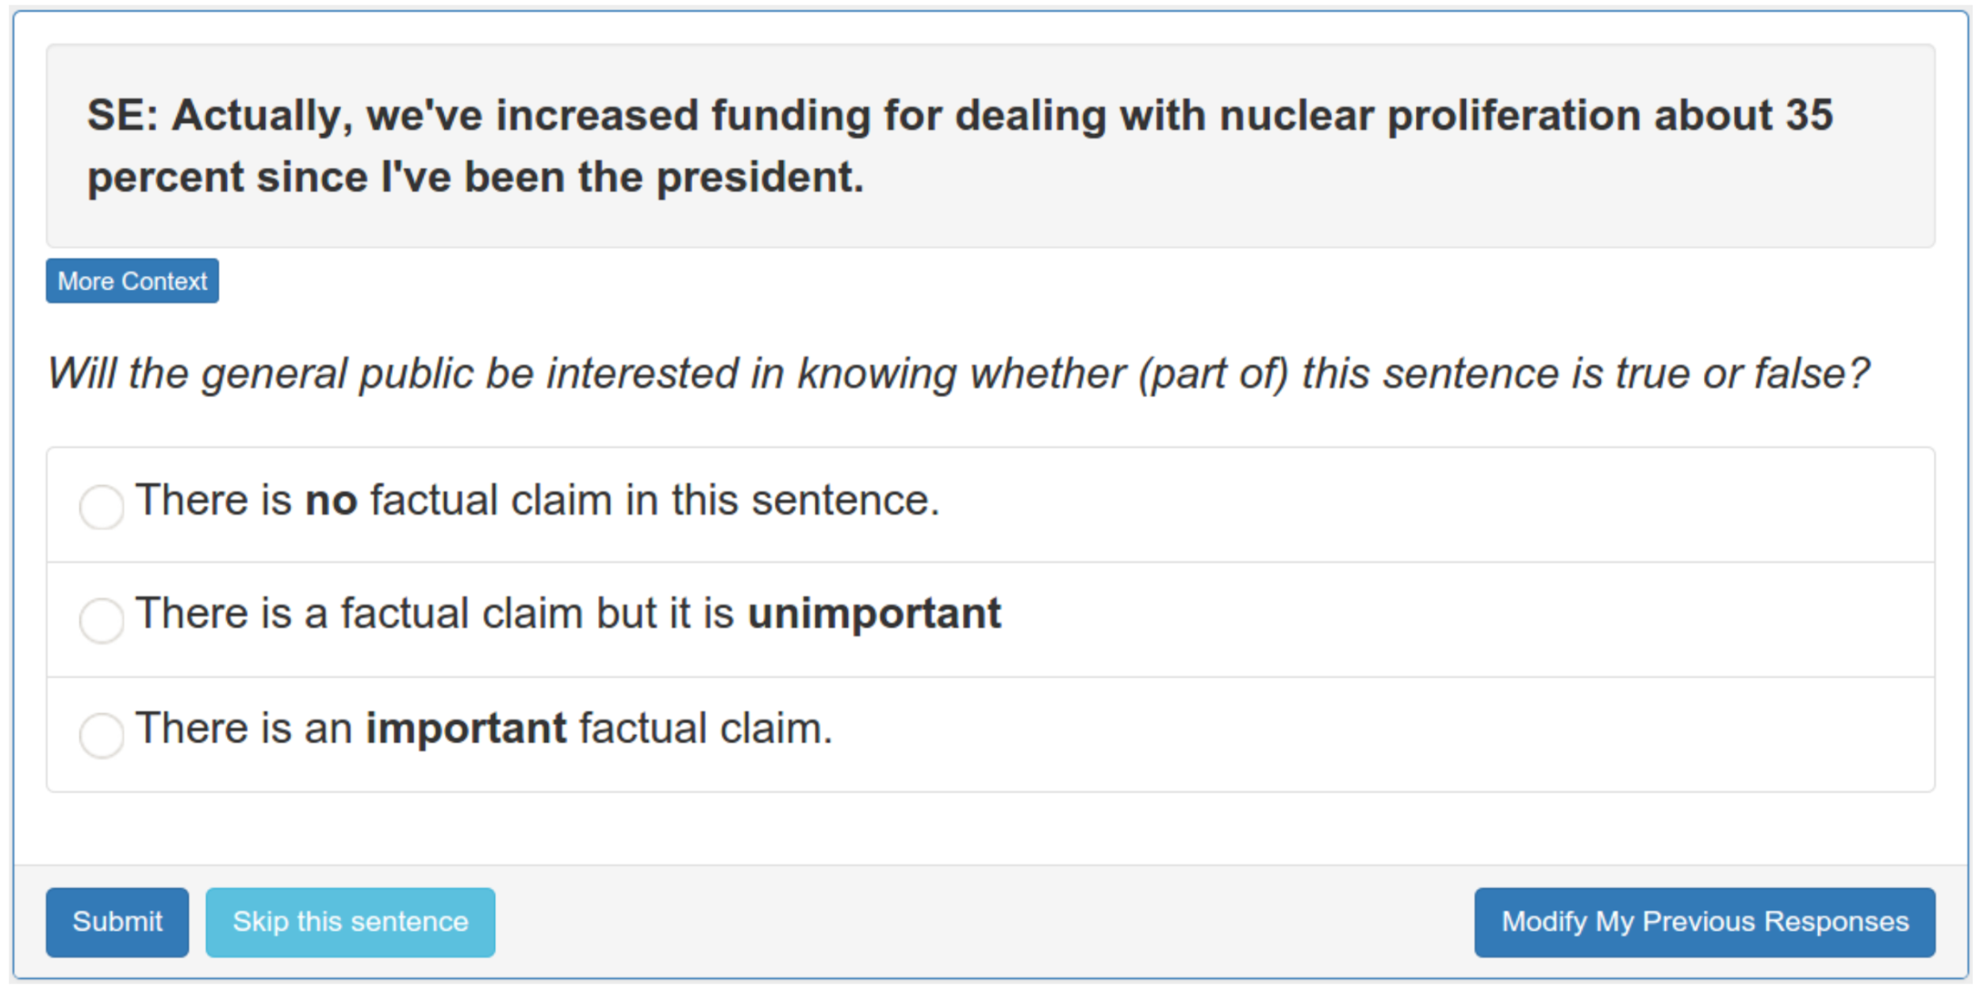
Claimbuster Annotation

Slide 19
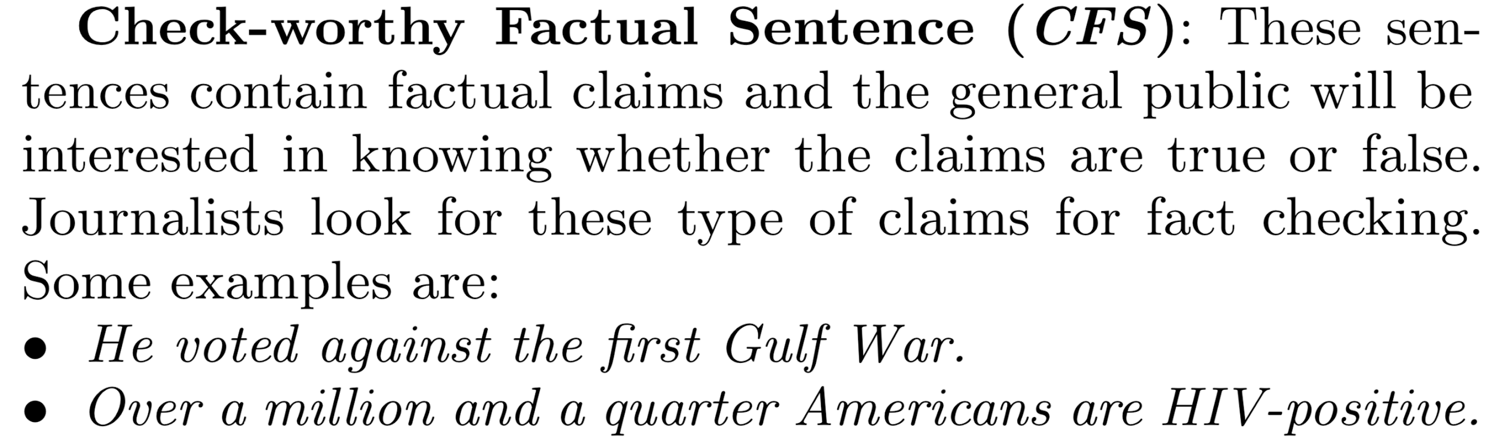
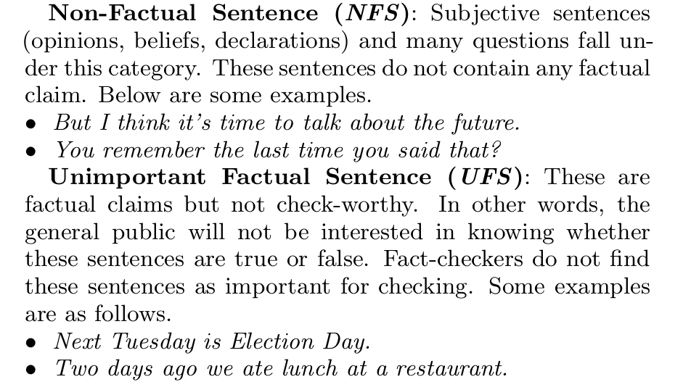
Claimbuster Annotation

Slide 20
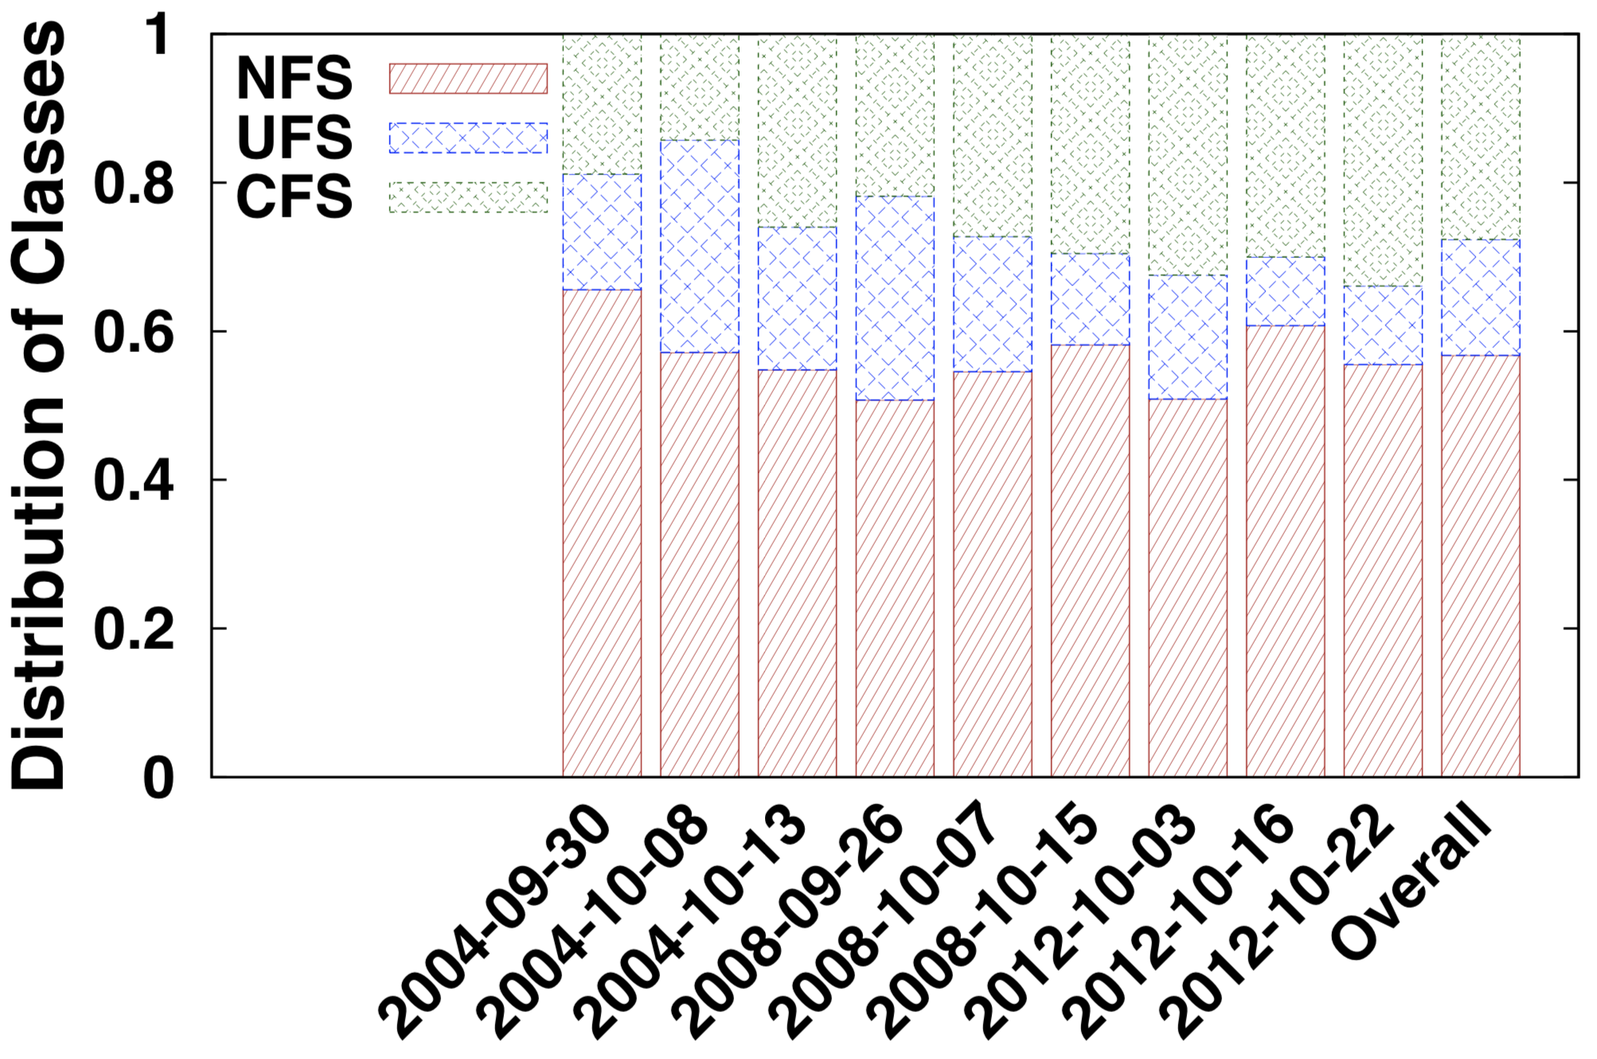
Claimbuster Data Distribution

Slide 21
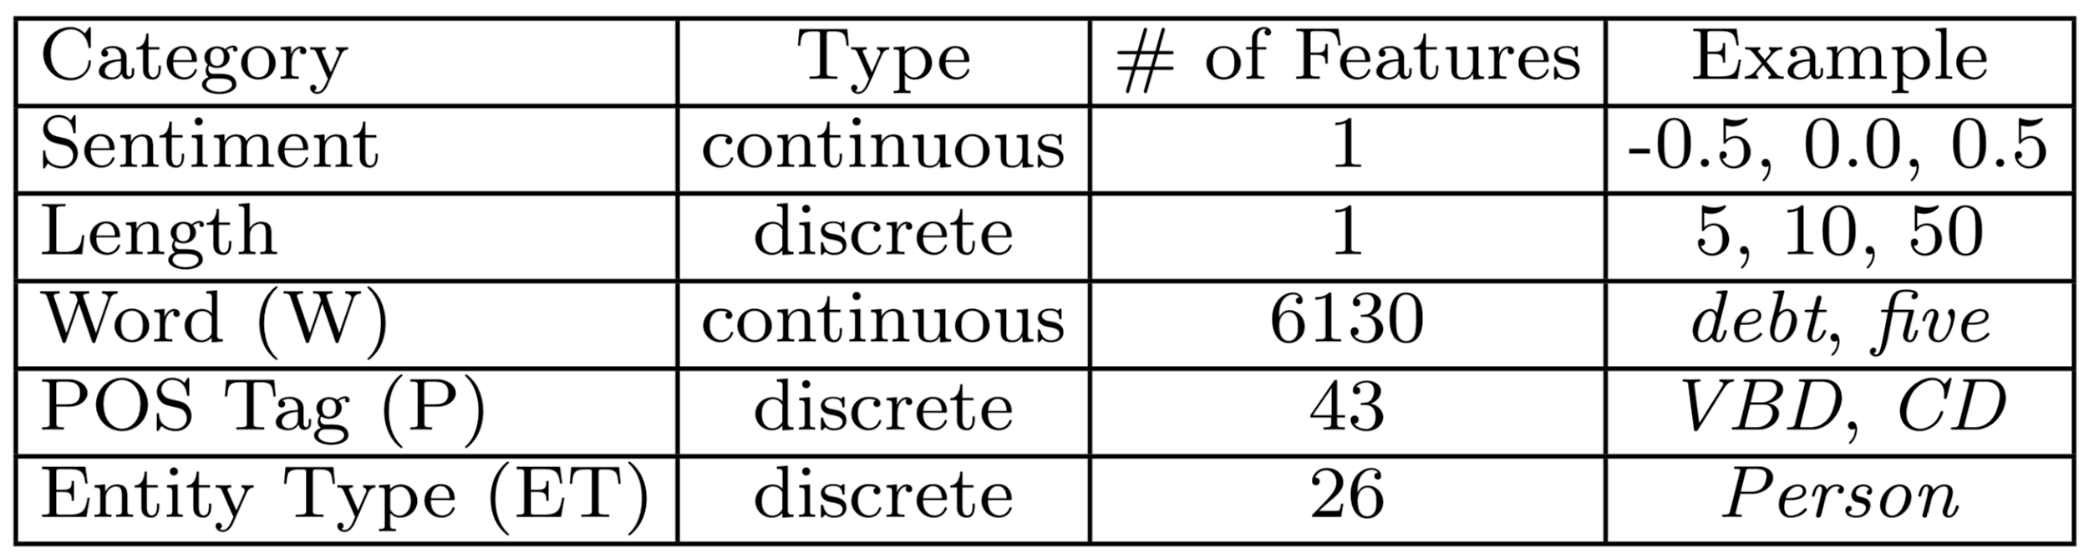
Claimbuster (Feature-based Classifier)

Slide 22
Automatic Fact-checking
Problem: people do not trust automatic methods
Yet, they trust human fact-checkers
Proposal: Look for previously fact-checked claims
politicians tend to repeat the same claims!
Given a check-worthy input claim and a set of verified-claims, rank those verified-claims, so that the claims that can help verify the input claim, or a sub-claim in it, are ranked above any claim that is not helpful to verify the input claim.

Slide 23
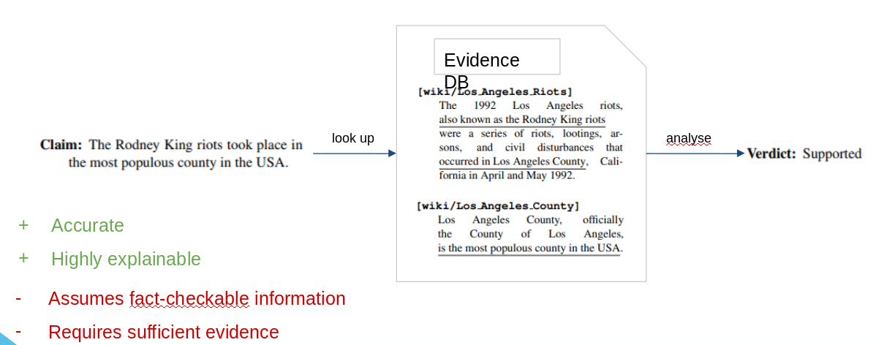
Automatic Fact-checking

Slide 24
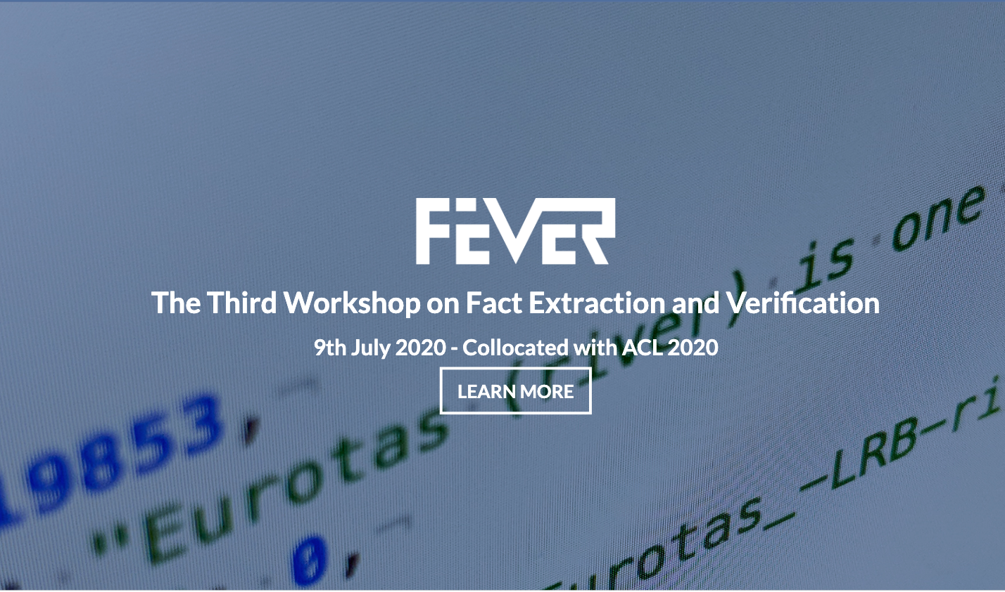
Fact-checking using Wikipedia

Slide 25
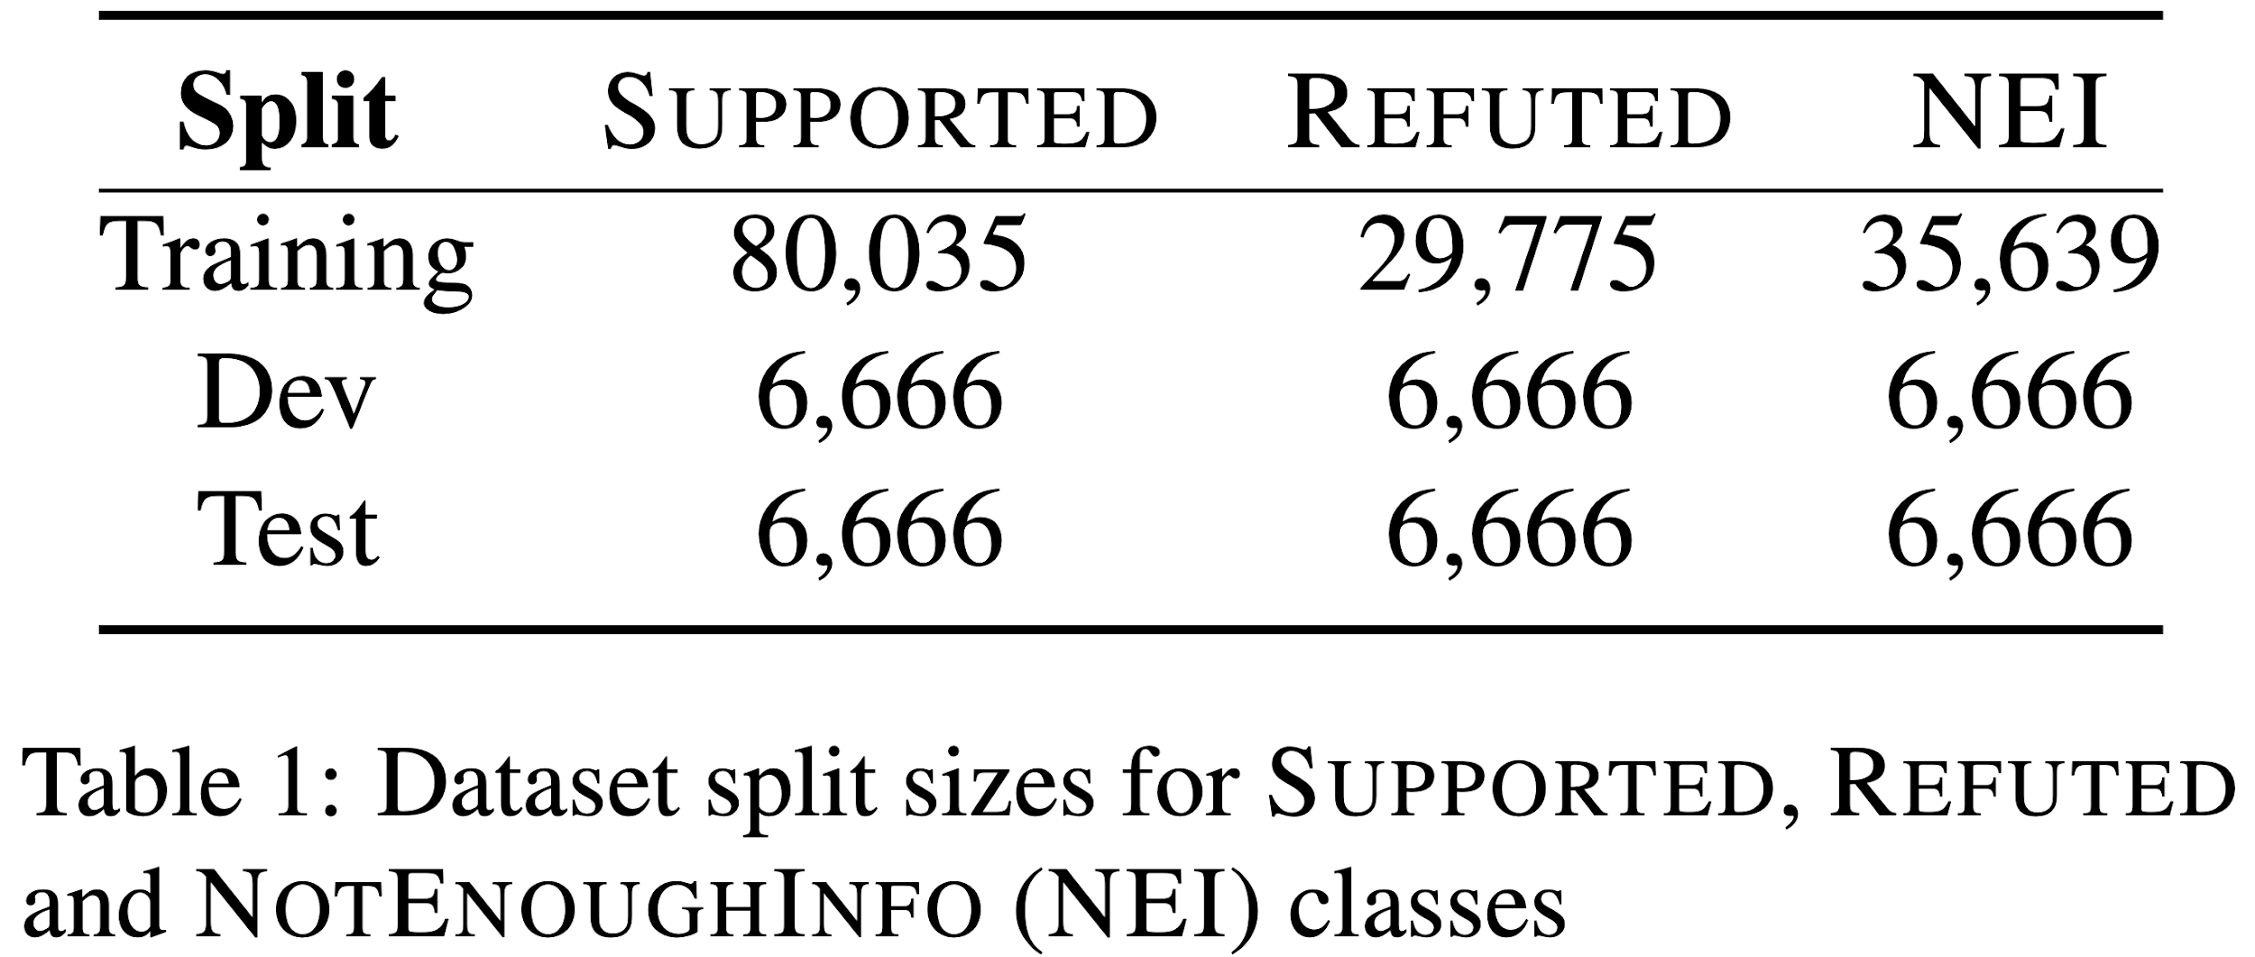
Fact-checking using Wikipedia

Slide 26
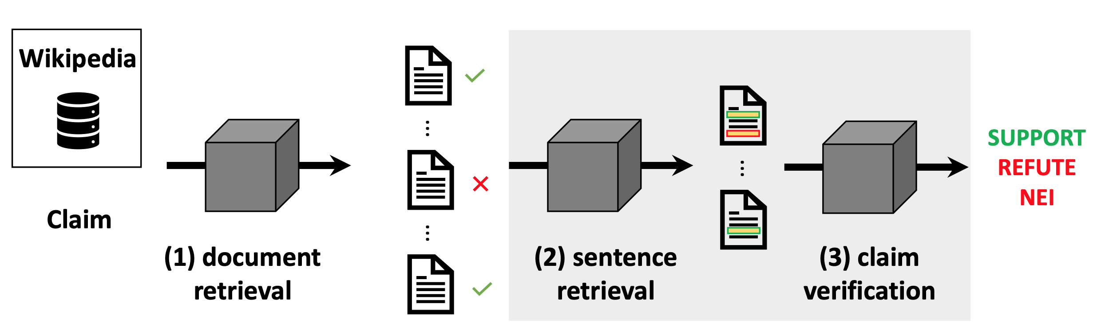
Fact-checking using Wikipedia

Slide 27
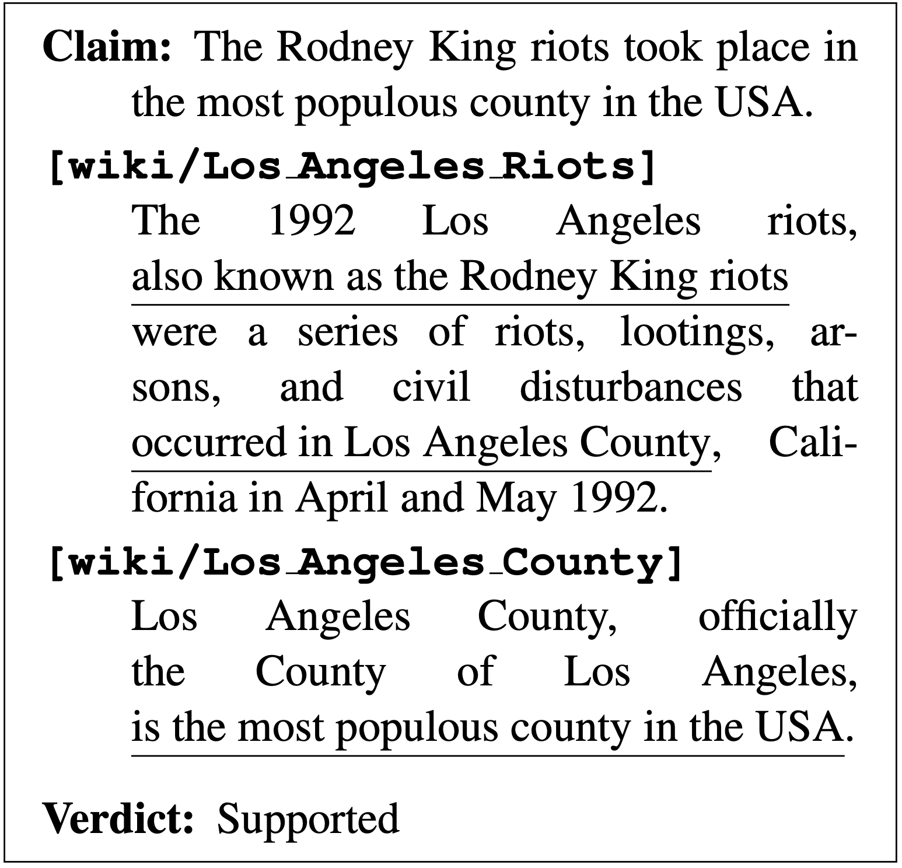
Multi-hop Fact-checking using Wikipedia

Slide 28
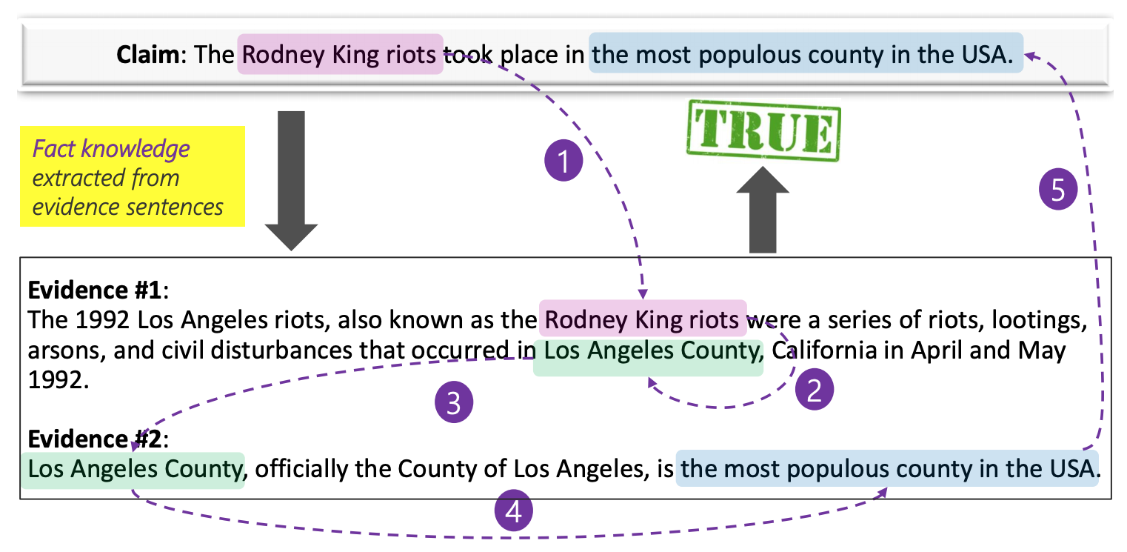
Fact-checking using SRL Graphs

Slide 29
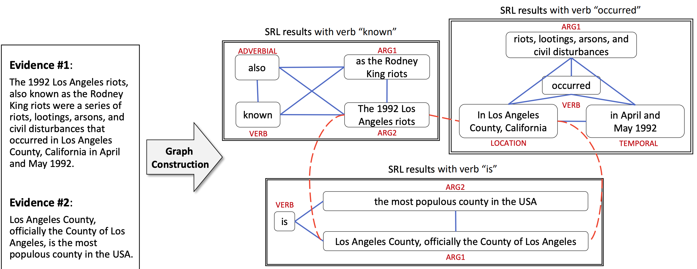
Fact-checking using SRL Graphs

Slide 30
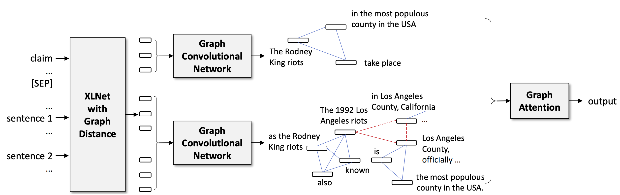
Fact-checking using SRL Graphs

Slide 31
Fact-checking
Explainable
Fact-checked claims
Wikipedia pages
Tables
Knowledge graphs
Non-explainable
Claim text
Perplexity
Language models
Web
Social media

Slide 32
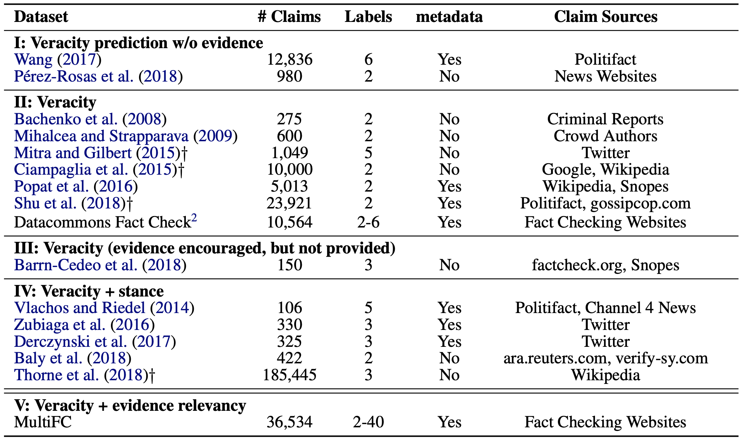
Fact-checking

Slide 33
Fake News Challenge: Stance Detection
Assessing the veracity of a news story is a complex and cumbersome task, even for trained experts
A helpful first step towards identifying fake news is to understand what other news organizations are saying about the topic (building block in an AI-assisted fact-checking pipeline)
Stance Detection:
Dynamic: With respect to a claim
Static: With respect to a topic

Slide 34
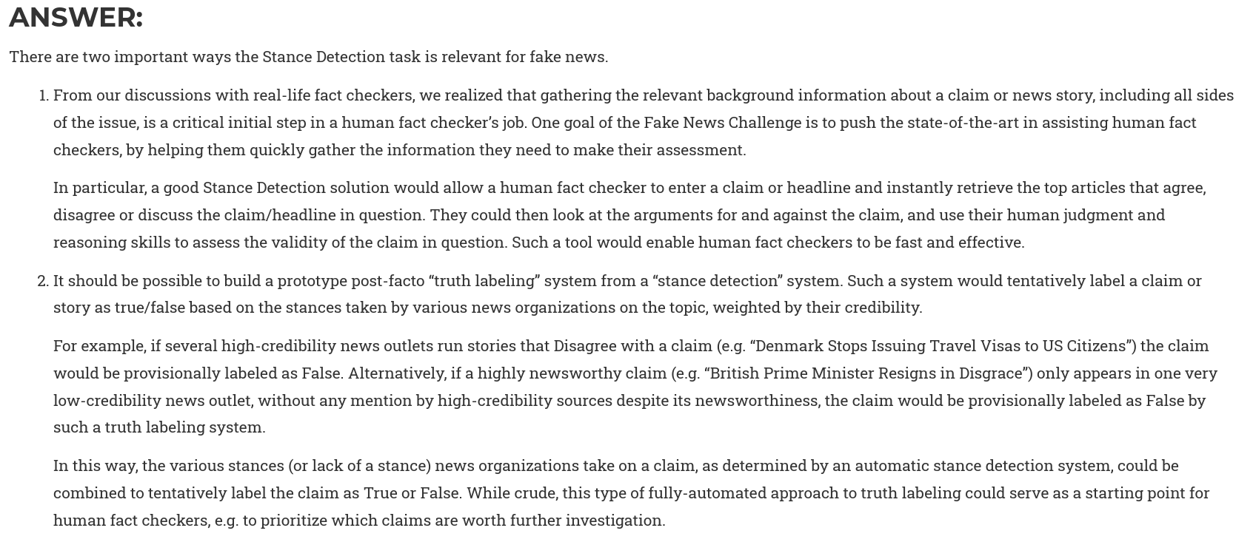
Why is stance detection relevant for fake news?
http://www.fakenewschallenge.org

Slide 35
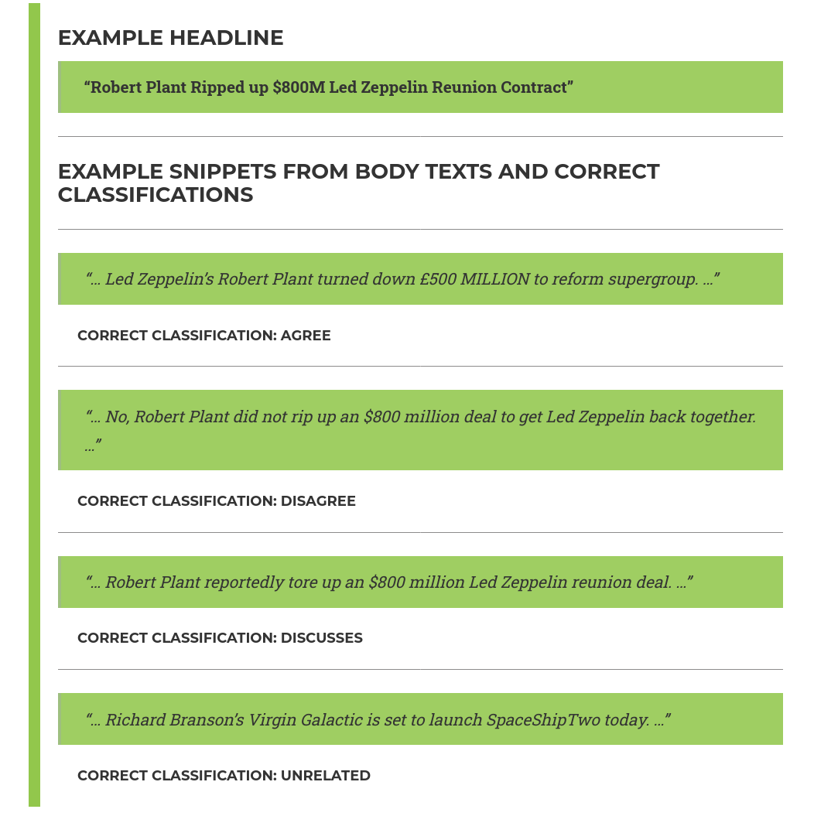
Fake news challenge
http://www.fakenewschallenge.org

Slide 36
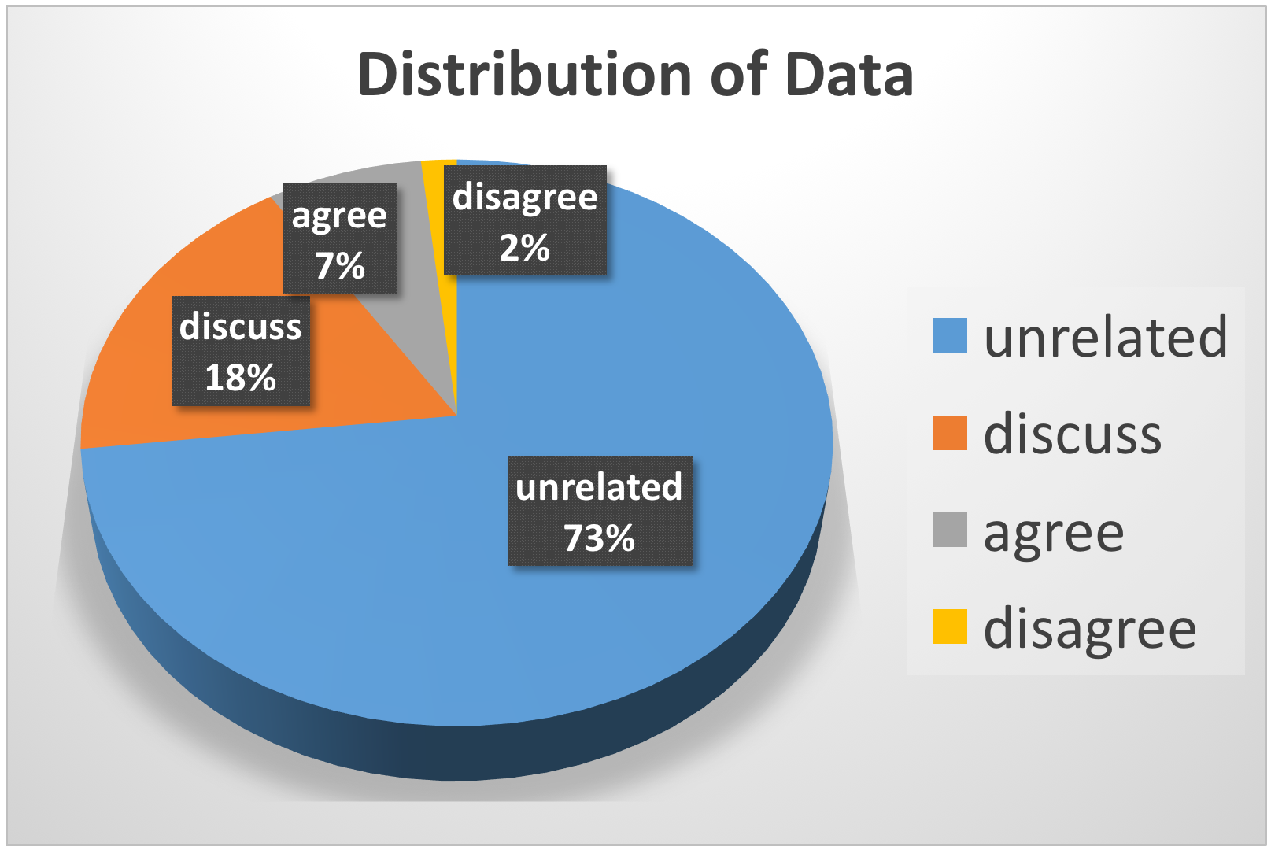
Fake news challenge: Dataset
http://www.fakenewschallenge.org

Slide 37
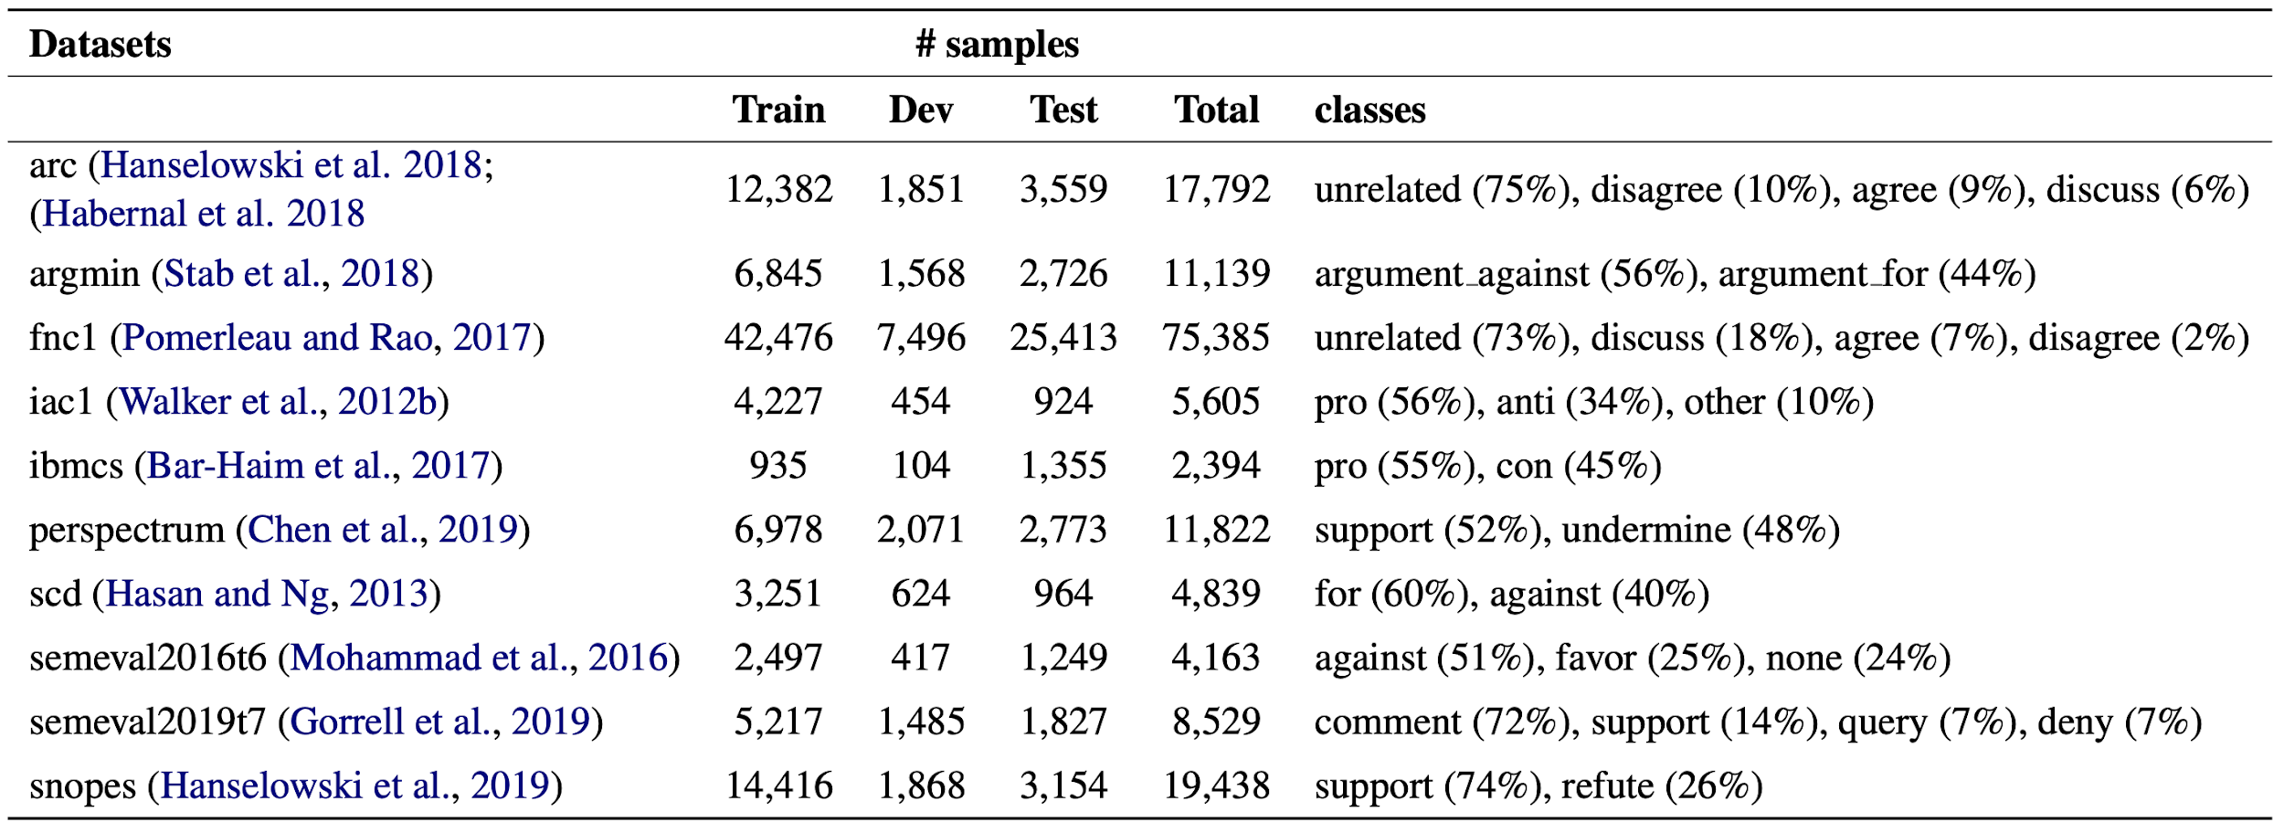
Stance Detection Datasets (English)

Slide 38
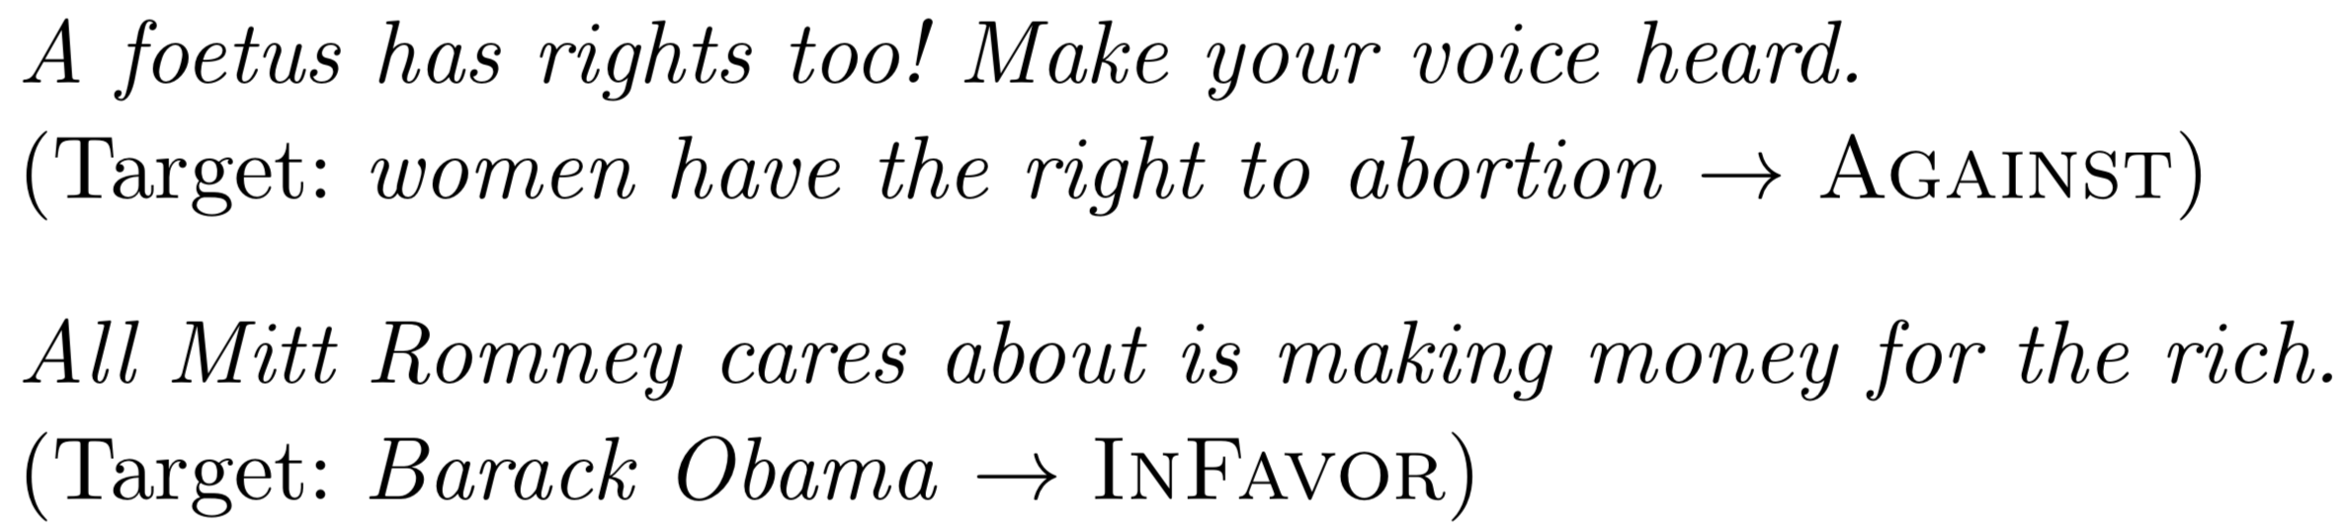
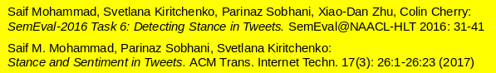
Stance Detection with respect to a topic

Slide 39
Stance Detection in Twitter: SemEval 2016
Task A (supervised framework) This task tested stance towards five targets: Atheism, Climate Change is a Real Concern,Feminist Movement, Hillary Clinton, and Legalization of Abortion.
2,914 labeled training data instances for the five targets. The test data included 1,249 instances.
Task B (weakly supervised framework) This task will test stance towards one target Donald Trump (707 tweets for testing).
The organizers did not provide any training data for this specific target, just a large set of unlabeled tweets associated with the target Donald Trump.

Slide 40
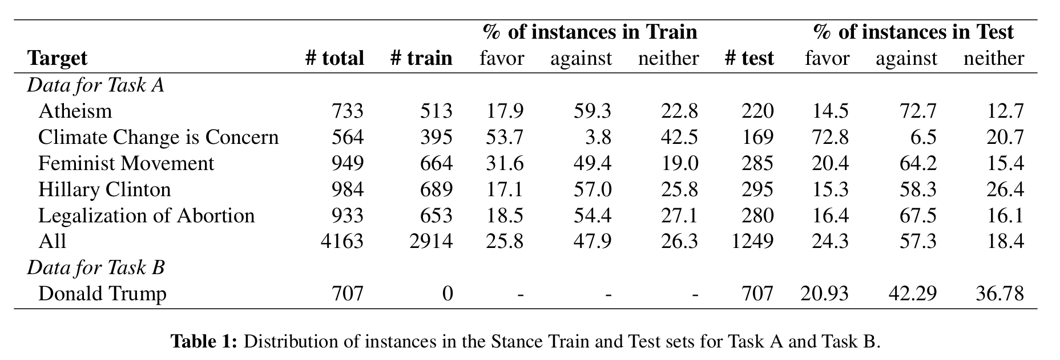
Stance Detection in Twitter: SemEval 2016

Slide 41
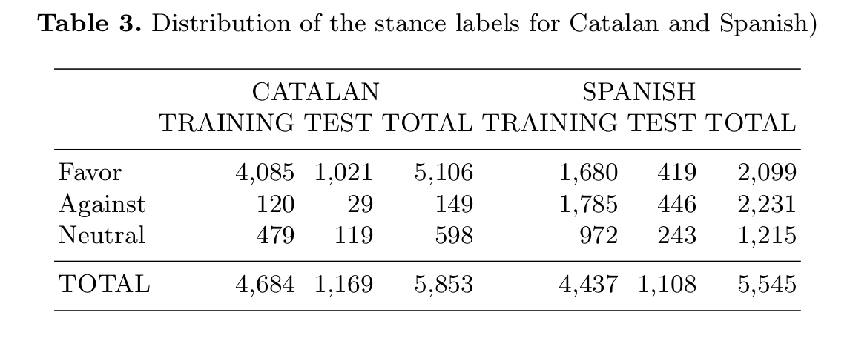
Stance Detection in Twitter: IberEval 2018
Taule et al. (2018). In IberEval.

Slide 42
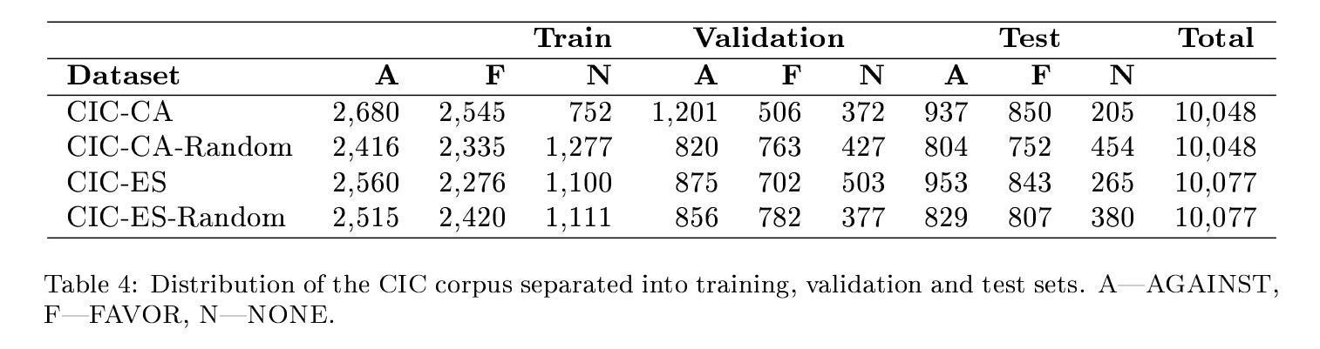
Stance Detection in Twitter: Catalonia Independence Corpus
Zotova et al. (2021). Semi-automatic generation of multilingual datasets for stance detection in Twitter. In Expert Systems with Applications.

Slide 43
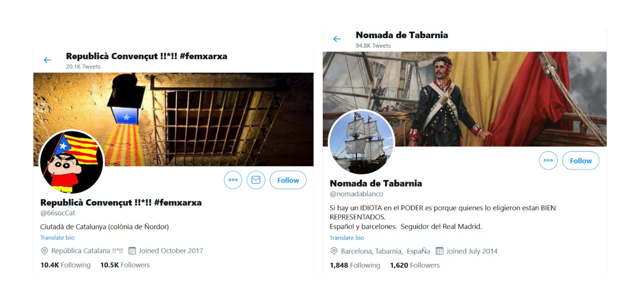
Stance Detection in Twitter: Catalonia Independence Corpus
Zotova et al. (2021). Semi-automatic generation of multilingual datasets for stance detection in Twitter. In Expert Systems with Applications.

Slide 44
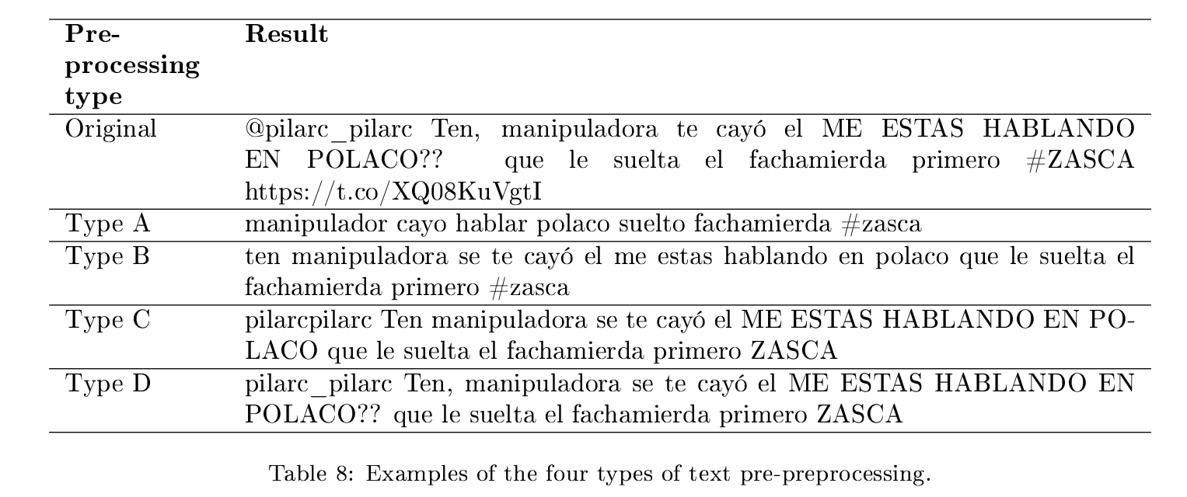
Stance Detection in Twitter: Catalonia Independence Corpus
Zotova et al. (2021). Semi-automatic generation of multilingual datasets for stance detection in Twitter. In Expert Systems with Applications.

Slide 45
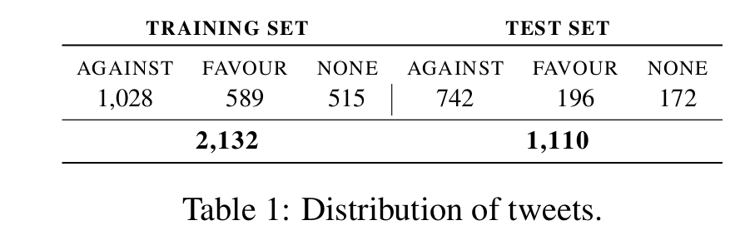
Stance Detection in Twitter: SardiStance 2020

Slide 46
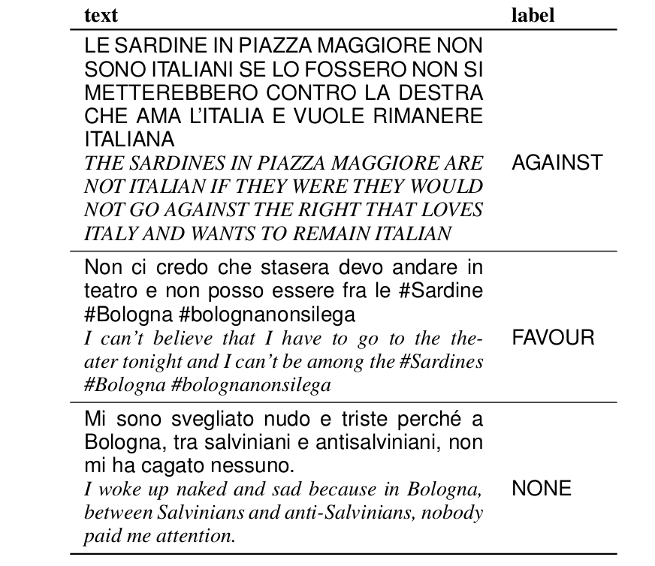
Stance Detection in Twitter: SardiStance 2020

Slide 47
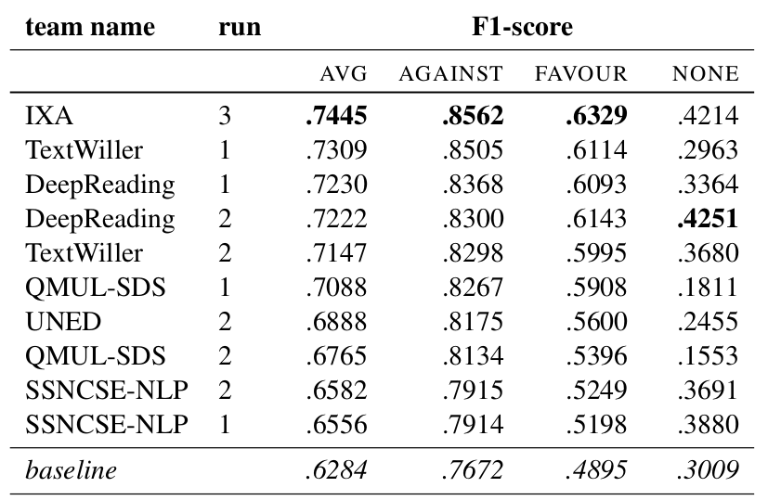
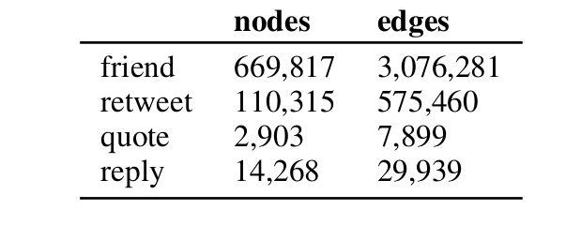
SardiStance 2020: Contextual Features
Cignarella et al. (2020). Overview of the EVALITA 2020 Task on Stance Detection in Italian Tweets (SardiStance). In Evalita 2020.

Slide 48
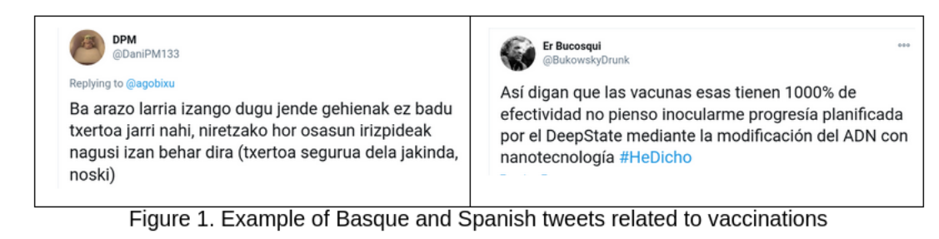
VaxxStance: Contextual and Multilingual
https://vaxxstance.github.io/

Slide 49
Automated Fact-checking: putting everything together
Augenstein (2021). Towards Explainable Fact-checking. In arxiv.

Slide 50
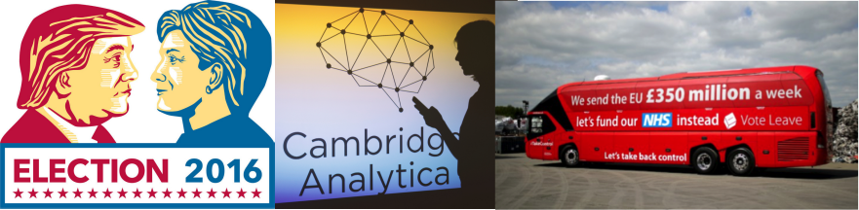
Propaganda
“The rise of the Internet […] has opened the creation and dissemination of propaganda messages, which were once the province of states and large institutions, to a wide variety of individuals and groups.”
Bolsover, G., & Howard, P. (2017). Computational Propaganda and Political Big Data: Moving Toward a More Critical Research Agenda. Big Data, 5(4), 273–276.

Slide 51
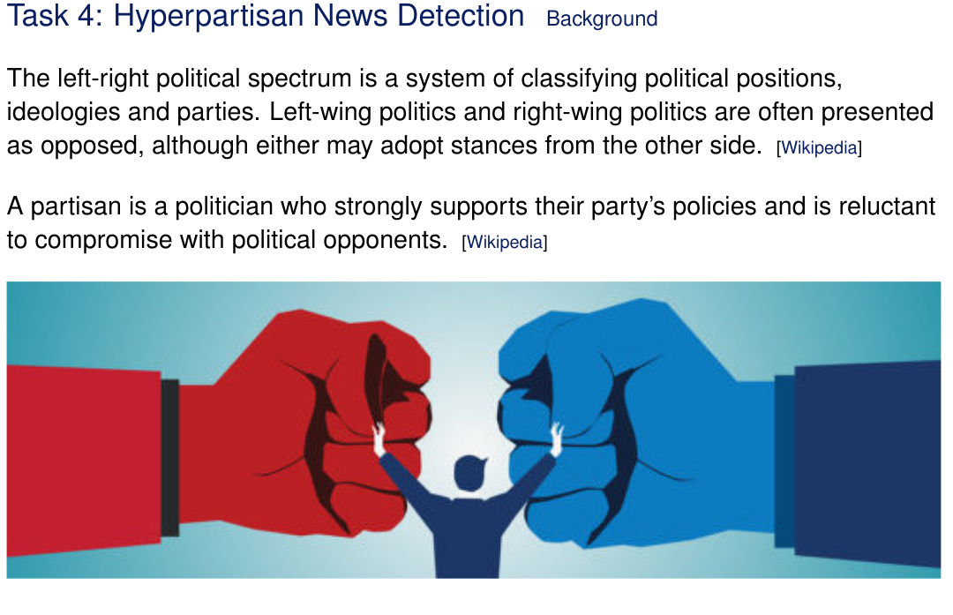
Detecting Propaganda at Document level
Johannes Kiesel, Maria Mestre, Rishabh Shukla, Emmanuel Vincent, Payam Adineh, David Corney, Benno Stein, and Martin Potthast. 2019. SemEval-2019 Task 4: Hyperpartisan News Detection. In Proceedings of The 13th International Workshop on Semantic Evaluation (SemEval 2019). 829–839.

Slide 52
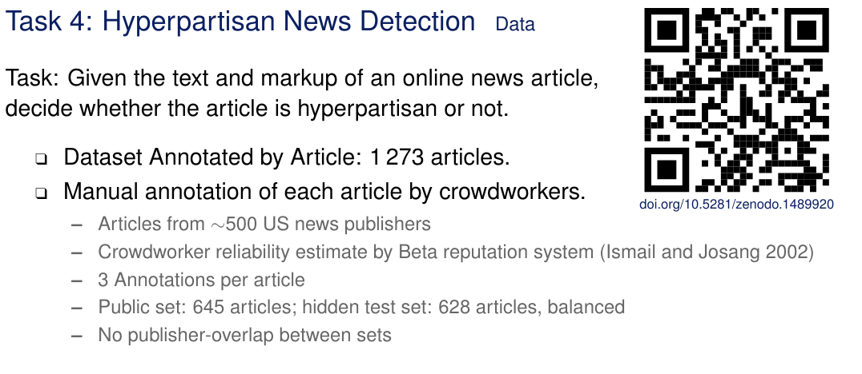
Detecting Propaganda at Document level
Johannes Kiesel, Maria Mestre, Rishabh Shukla, Emmanuel Vincent, Payam Adineh, David Corney, Benno Stein, and Martin Potthast. 2019. SemEval-2019 Task 4: Hyperpartisan News Detection. In Proceedings of The 13th International Workshop on Semantic Evaluation (SemEval 2019). 829–839.

Slide 53

Detecting Propaganda at Document level
Johannes Kiesel, Maria Mestre, Rishabh Shukla, Emmanuel Vincent, Payam Adineh, David Corney, Benno Stein, and Martin Potthast. 2019. SemEval-2019 Task 4: Hyperpartisan News Detection. In Proceedings of The 13th International Workshop on Semantic Evaluation (SemEval 2019). 829–839.

Slide 54
Concluding remarks
Text Classification tasks:
Natural Language Inference tasks:

Slide 55
Bibliography
1. Towards explainable fact-checking: https://arxiv.org/pdf/2108.10274.pdf
2. Semeval 2016 task on stance detection: https://www.aclweb.org/anthology/S16-1003/
3. Multilingual Stance Detection (Related Work section): https://arxiv.org/abs/2101.11978

